Slide 1




Slide 2







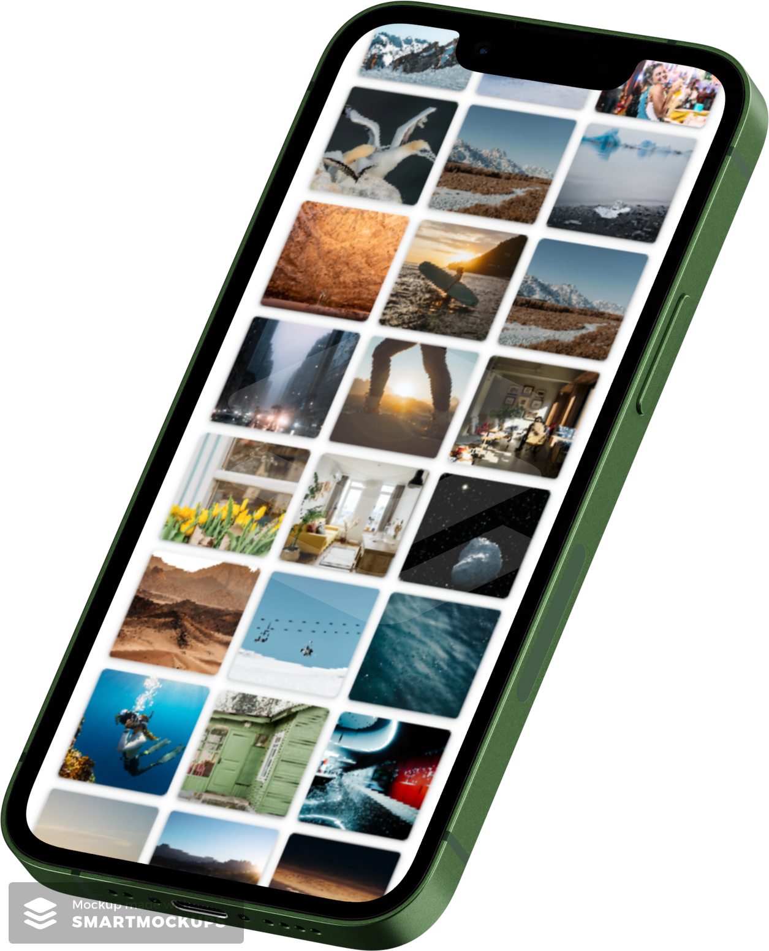
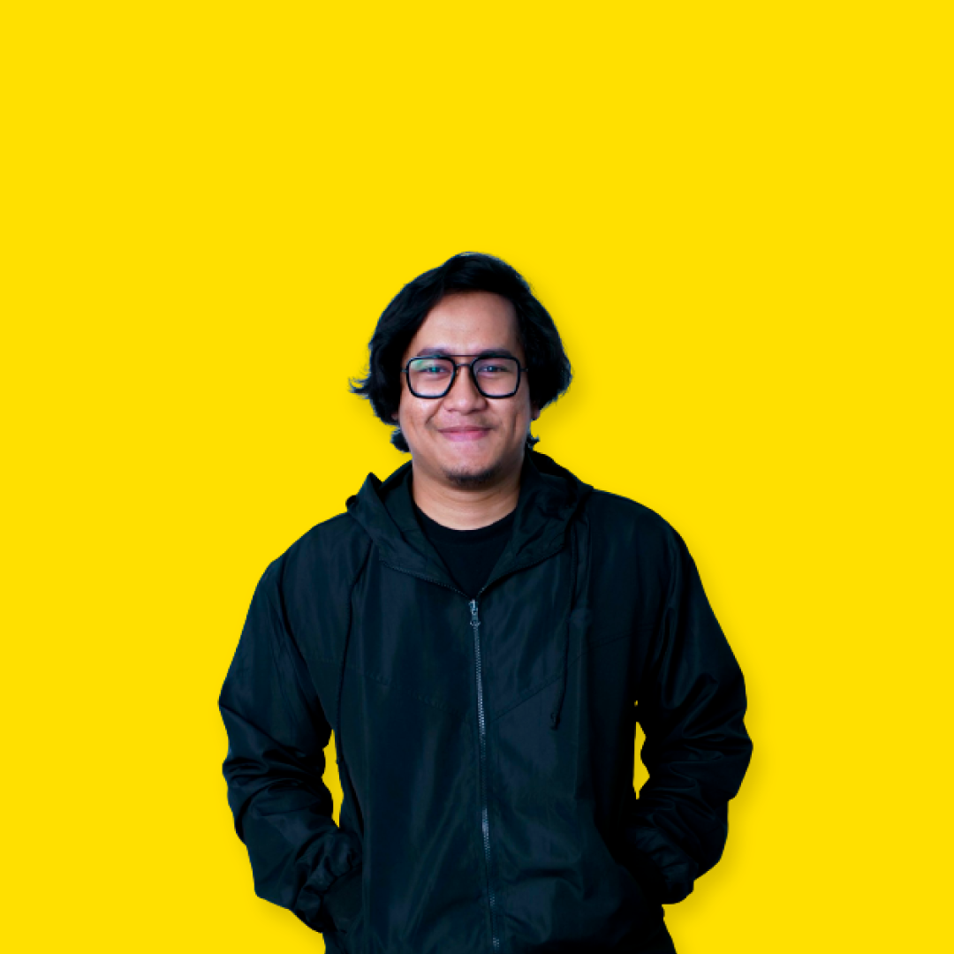
Fullstack Developer Trainee
Phintraco Consulting
2024
Usaid Alkamil Anshorulloh
Purwadhika Digital Technology School
Fullstack Web Development
2023
2 Januari
1999
Institut Pertanian Bogor
Fakultas Perikanan dan Ilmu Kelautan
2017 - 2022
Ps. Rebo, Jakarta Timur

Slide 3











Usaid Alkamil Anshorulloh
Fullstack Developer Trainee
Phintraco Consulting
2024
2 January
1999
Purwadhika Digital Technology School
Fullstack Web Development
2023
Institut Pertanian Bogor
Faculty of Fisheries and Marine Science
2017 - 2022
Ps. Rebo, Jakarta Timur
Back End

Slide 4








Usaid Alkamil Anshorulloh
Fullstack Developer Trainee
Phintraco Consulting
2024
Back End
2 Januari
1999
Purwadhika Digital Technology School
Fullstack Web Development
2023
Institut Pertanian Bogor
Fakultas Perikanan dan Ilmu Kelautan
2017 - 2022
Ps. Rebo, Jakarta Timur
Front End

Slide 5
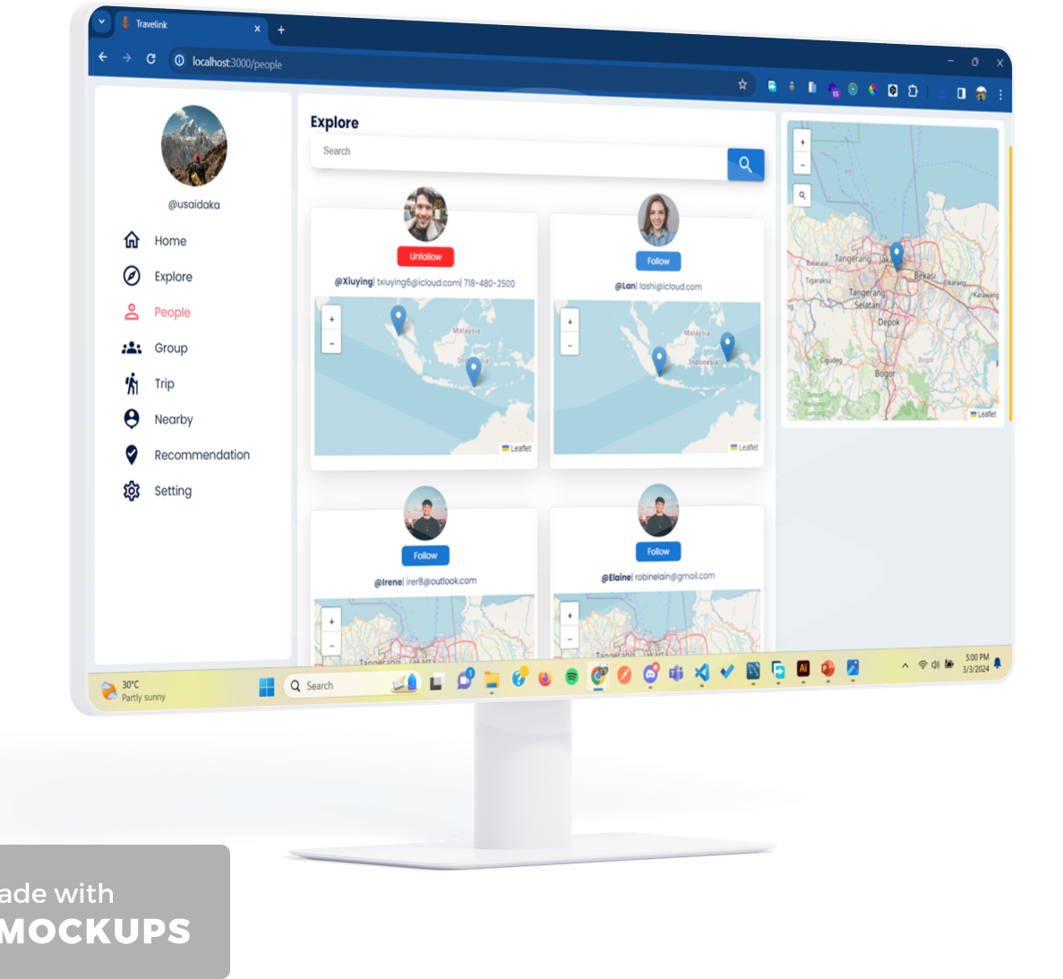
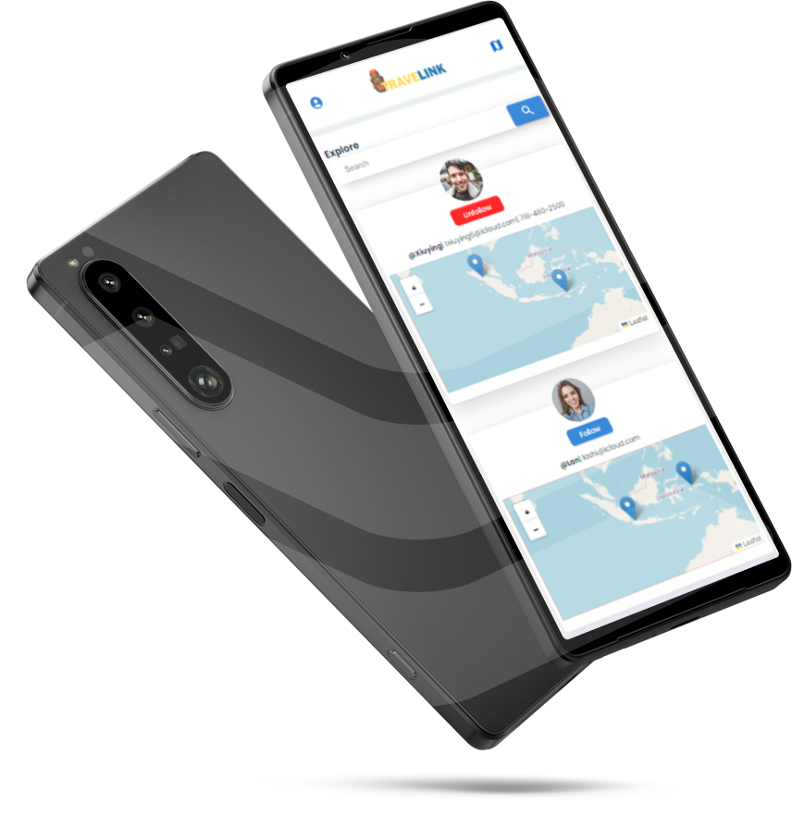
Back End
FEATURES
Maps
People Nearby Current Location
People Nearby Direction Location
Register my trip
Admin register destination recommendation
Front End
Mini Social Media
Following each other
Create trip group
Posting My Photo
Comment in another post
Delete my comment
Edit my post
Delete my post

Slide 6
Back End
FEATURES
Maps
People Nearby Current Location
People Nearby Direction Location
Register my trip
Admin register destination recommendation
Mini Social Media
Following each other
Create trip group
Posting My Photo
Comment in another post
Delete my comment
Edit my post
Delete my post
alur program (project structure or architecture/activity diagram/flowchart/sequence diagram)
Front End

Slide 7
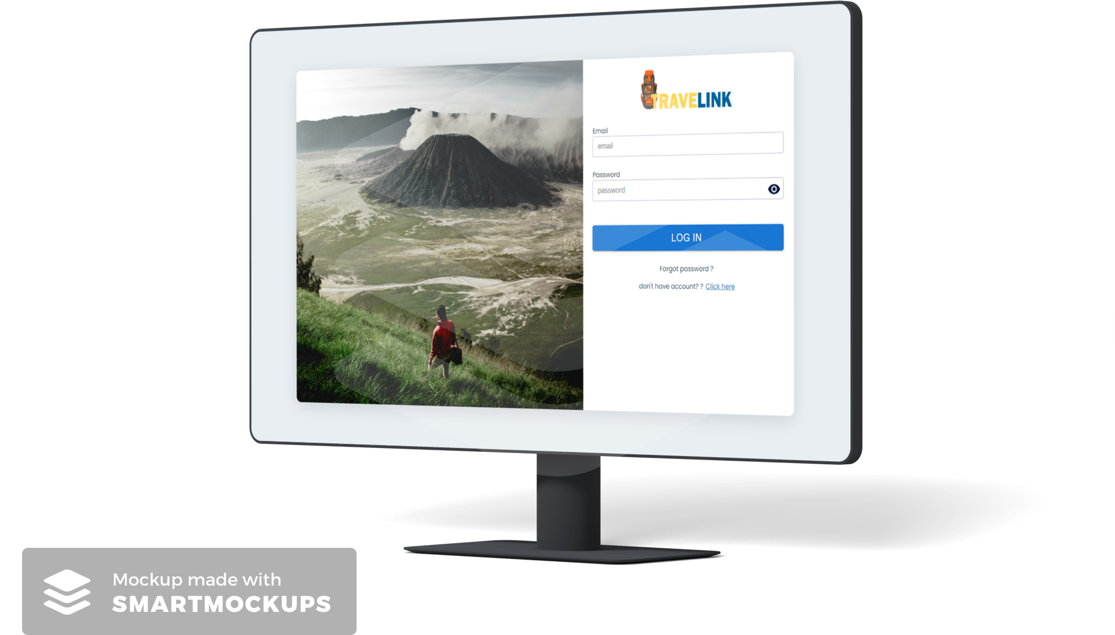
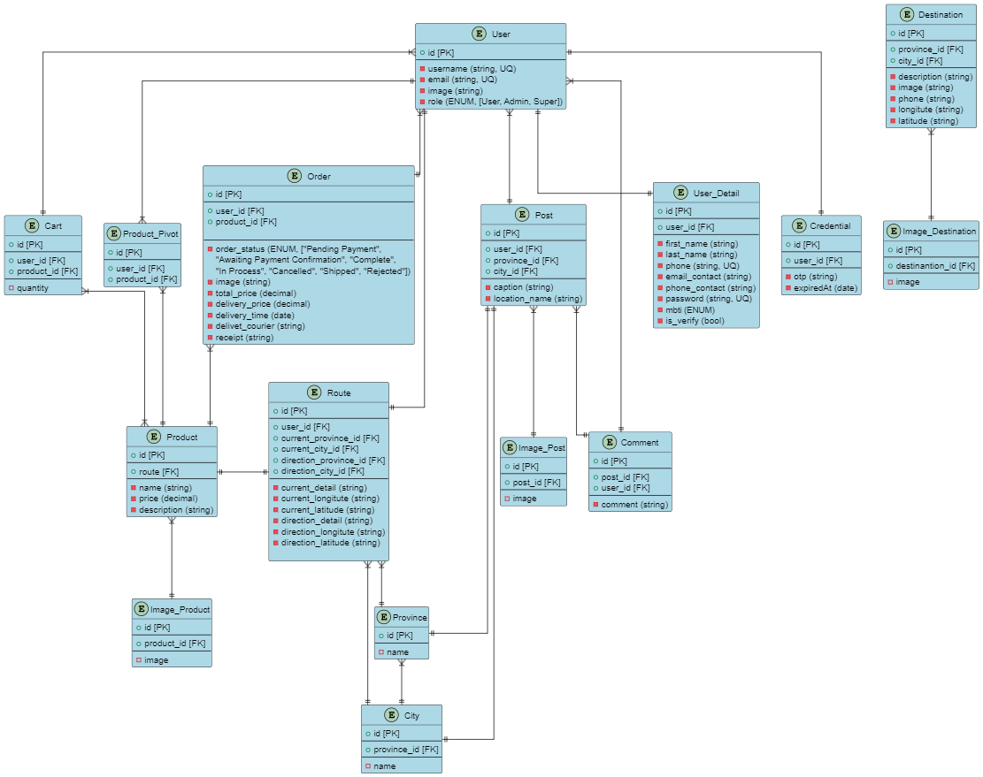
Features
Maps
People Nearby Current Location
People Nearby Direction Location
Register my trip
Admin register destination recommendation
Mini Social Media
Following each other
Create trip group
Posting My Photo
Comment in another post
Delete my comment
Edit my post
Delete my post
FLOWCHART USER
Comment post
Find following post?
No
Follow Someone
false
password match?
true
home
Create post?
Yes
Posting a post
login
No
register
Trip
Destination recommendation
No
Have idea where to go?
Have a trip?
Create group with your nearby
Make a trip
Yes
No
Yes
Find nearby

Slide 8
Features
Maps
People Nearby Current Location
People Nearby Direction Location
Register my trip
Admin register destination recommendation
Mini Social Media
Following each other
Create trip group
Posting My Photo
Comment in another post
Delete my comment
Edit my post
Delete my post
FLOWCHART ADMIN
false
Is destination available?
login
password match?
true
dashboard
destination
No
Register destination
Yes
Modify destination
Delete destination
Edit destination

Slide 9
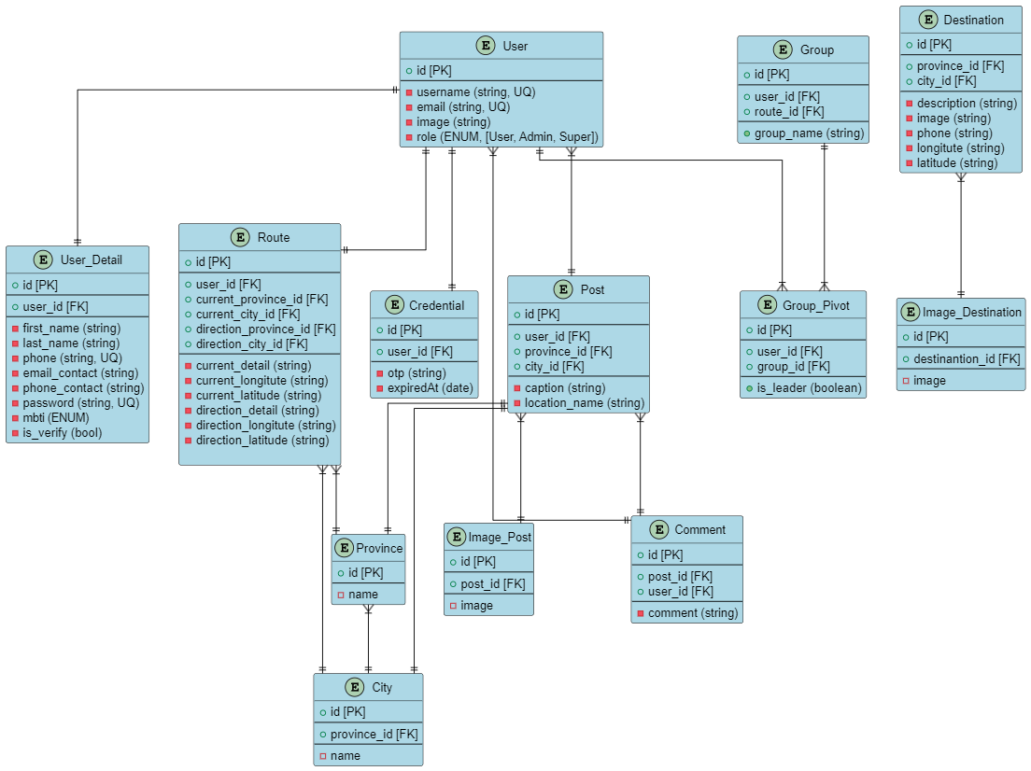
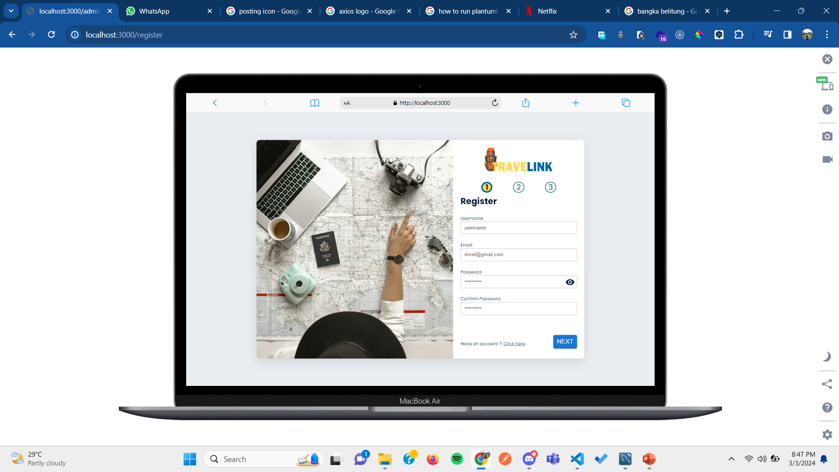
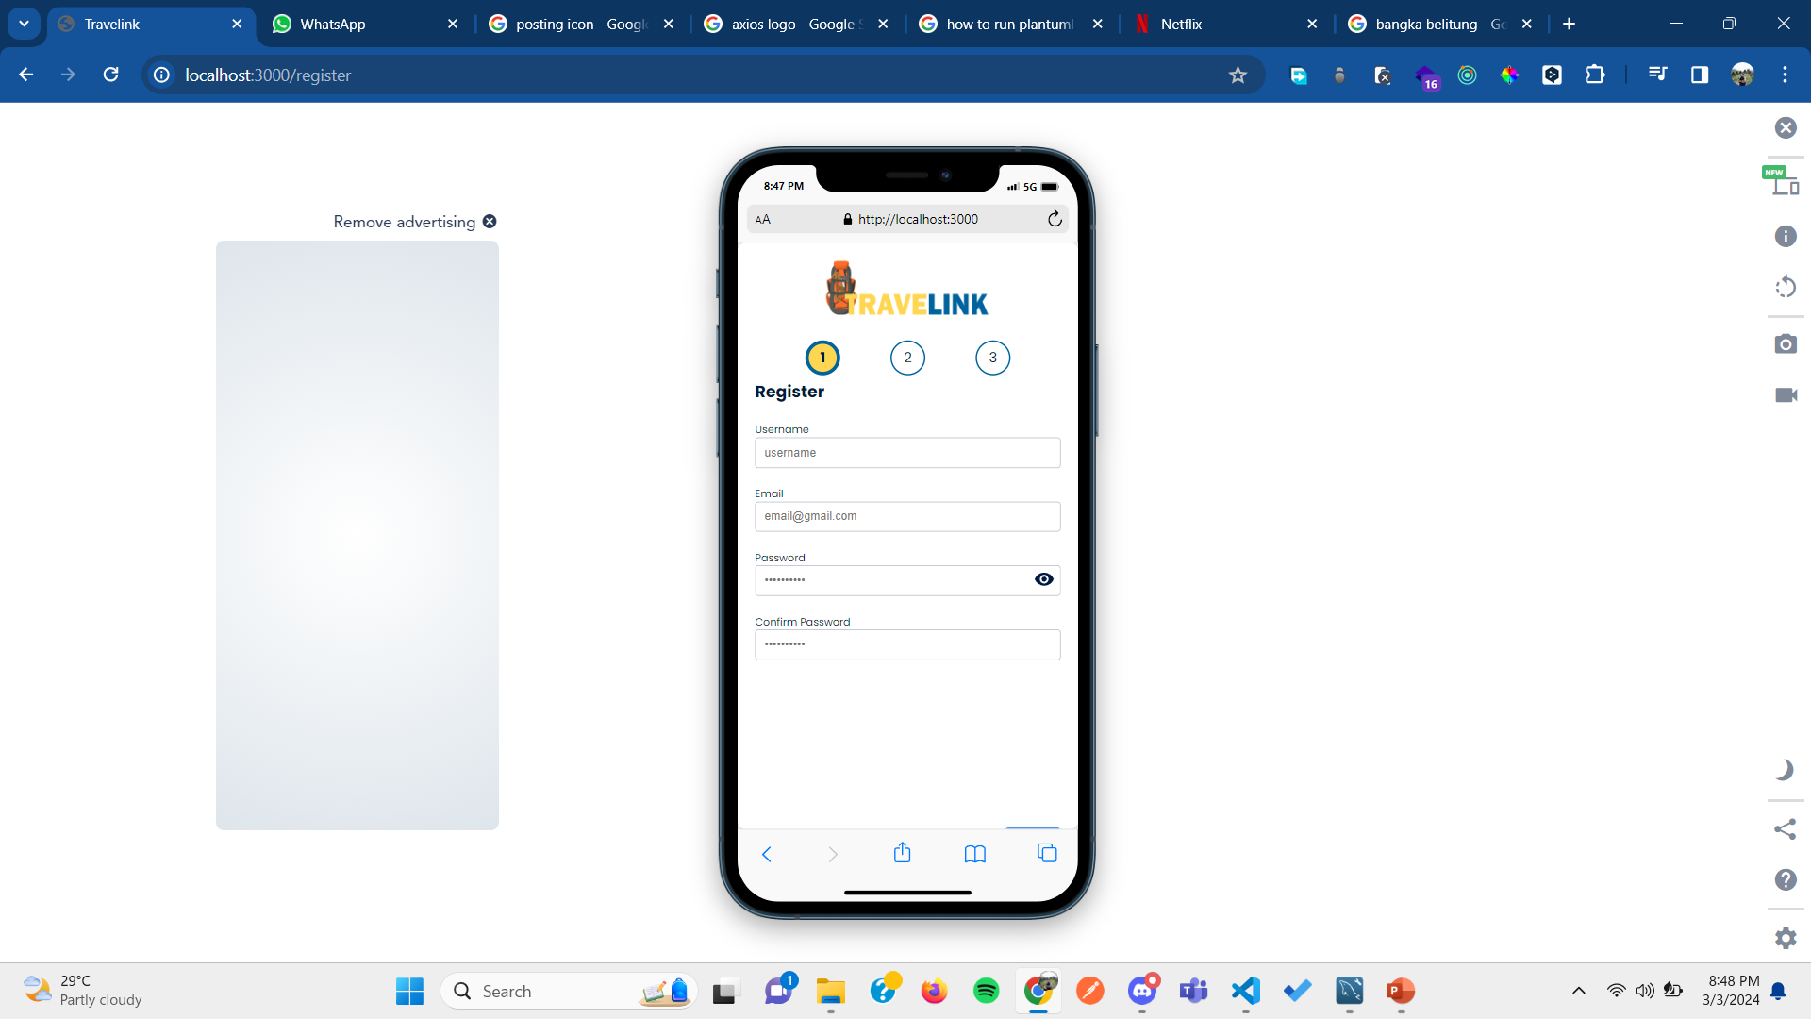
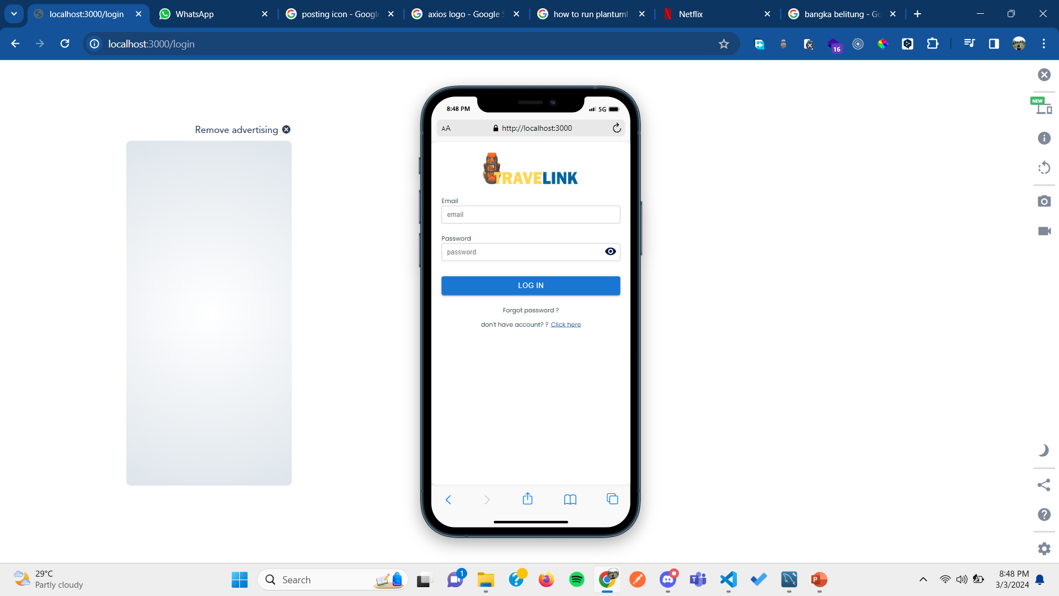
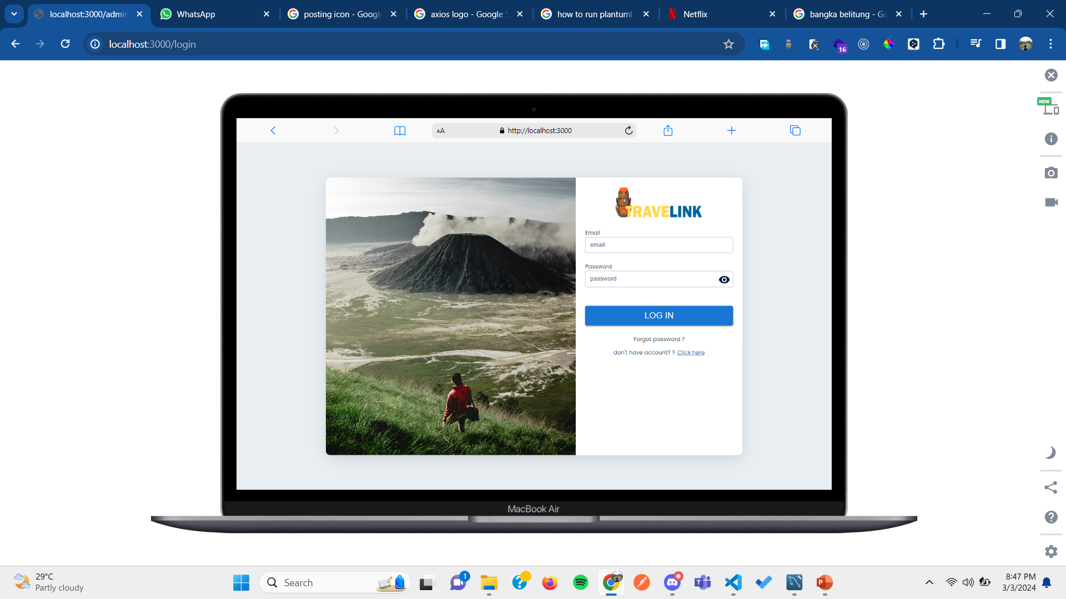
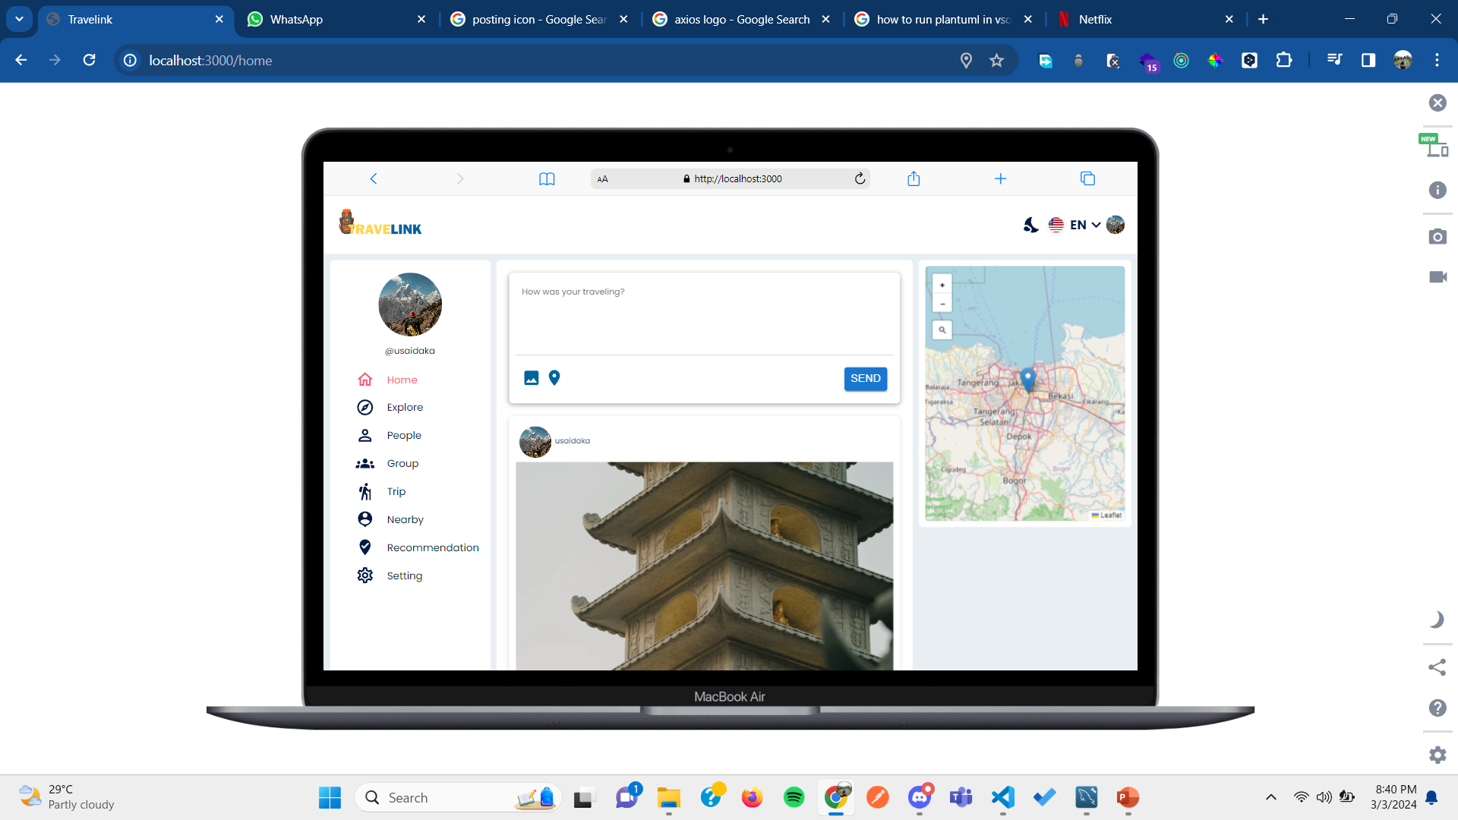
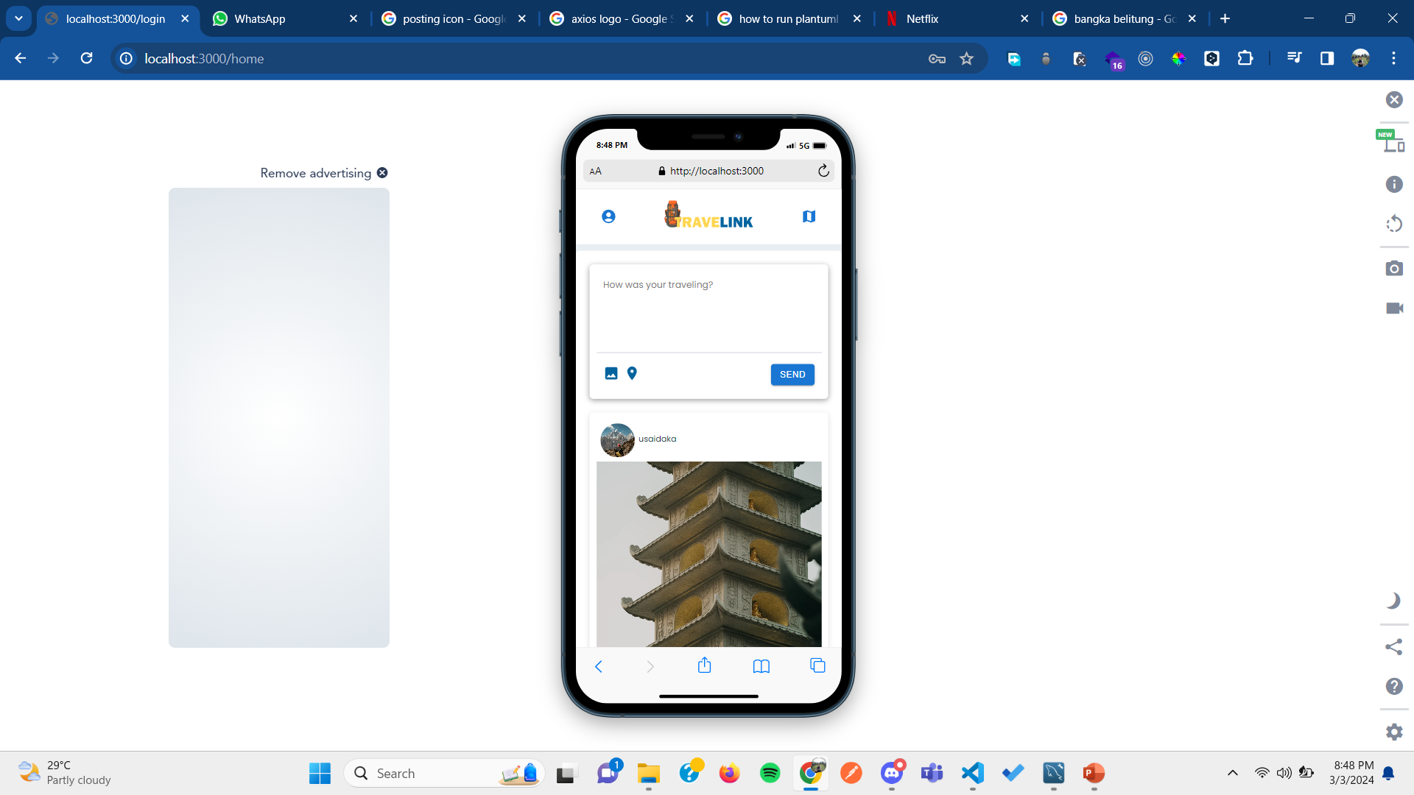
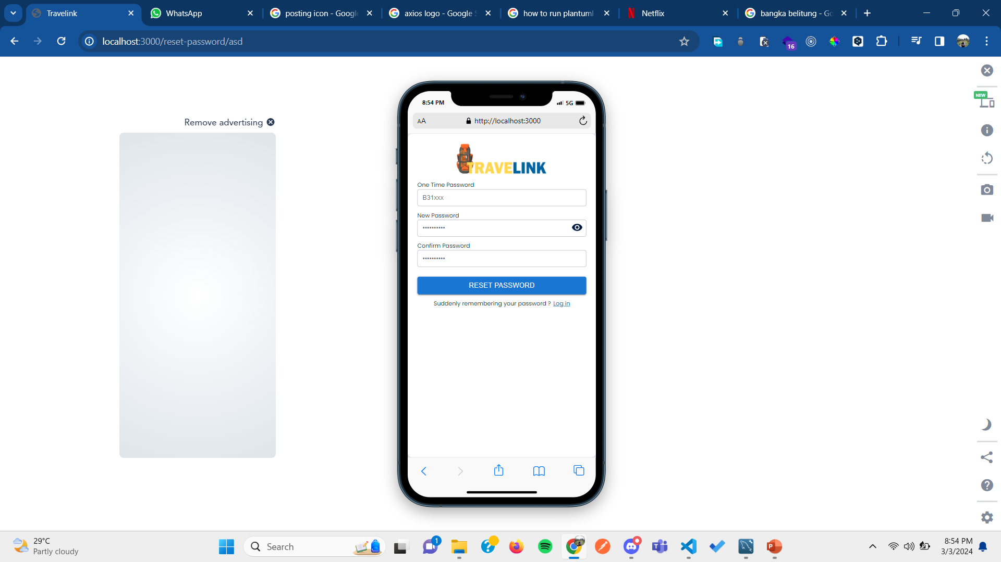
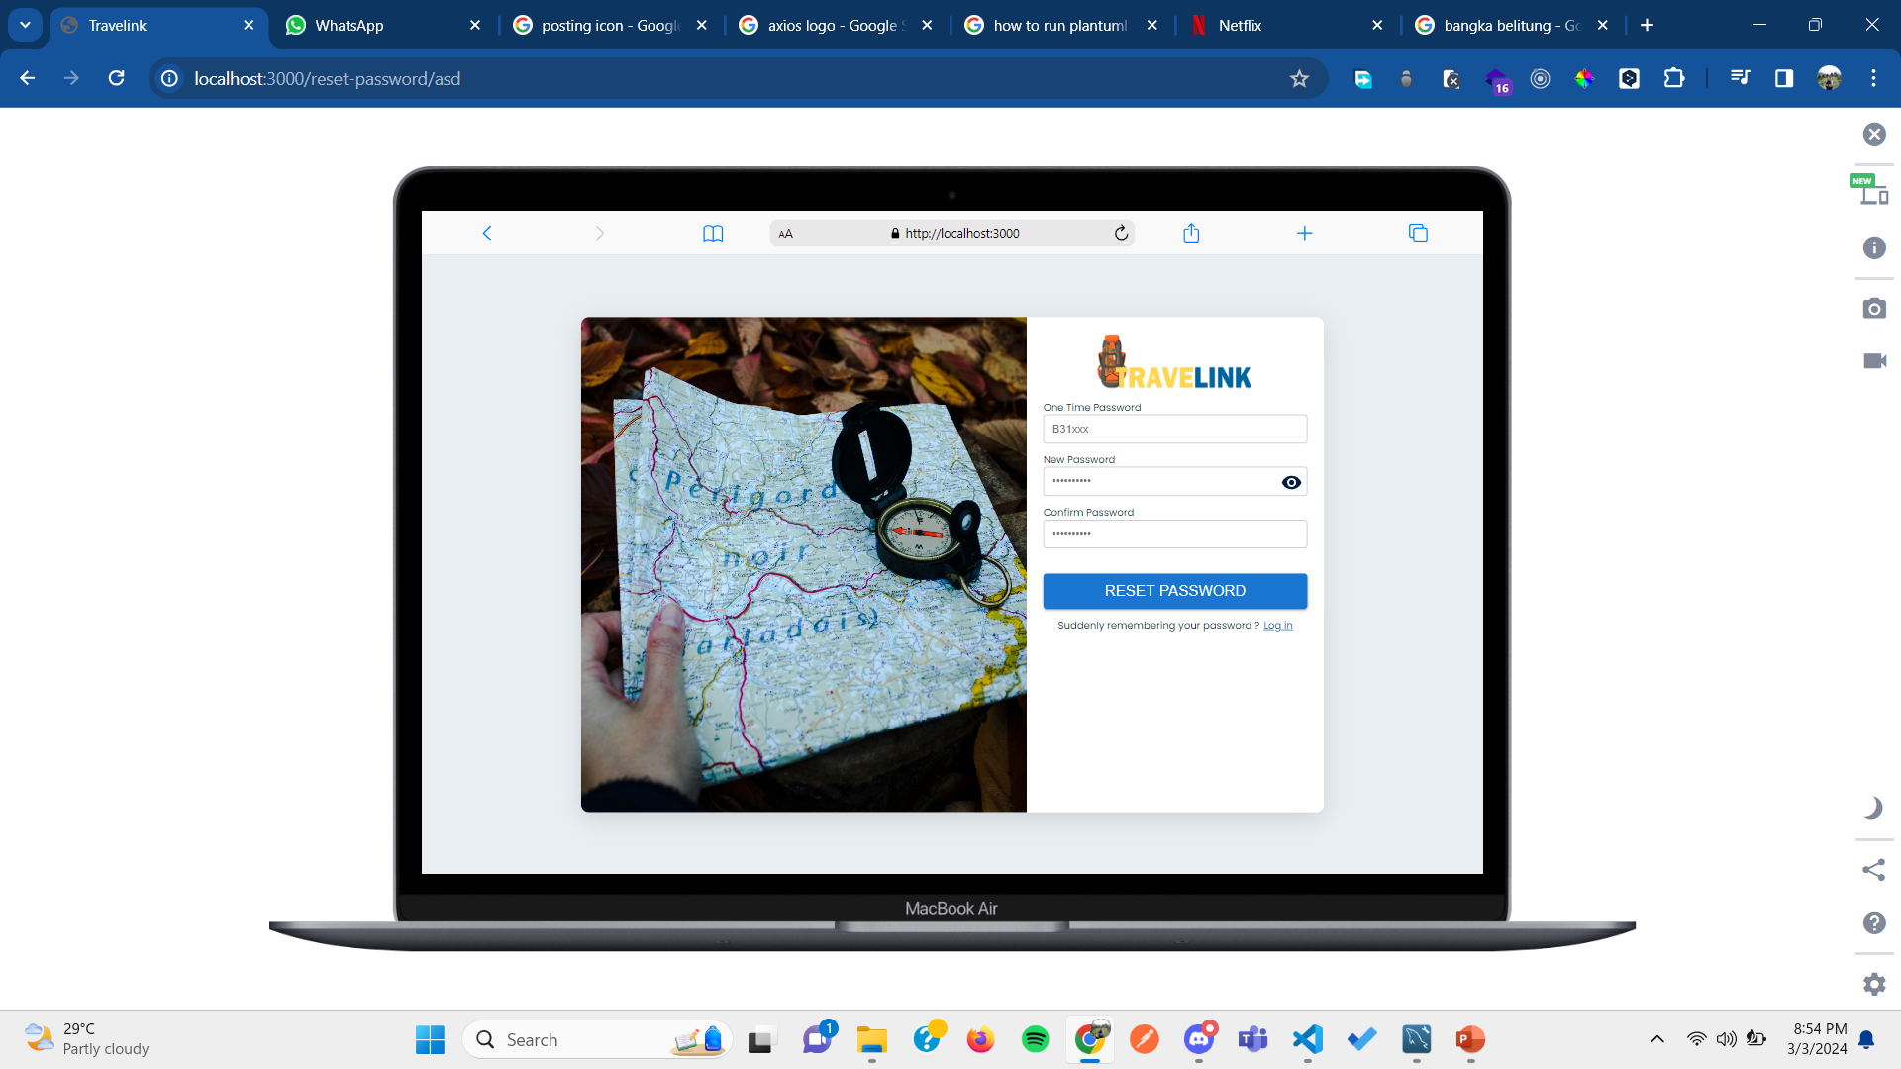
alur program (project structure or architecture/activity diagram/flowchart/sequence diagram)
Entity
Relational
Diagram
register
login
home
reset password

Slide 10
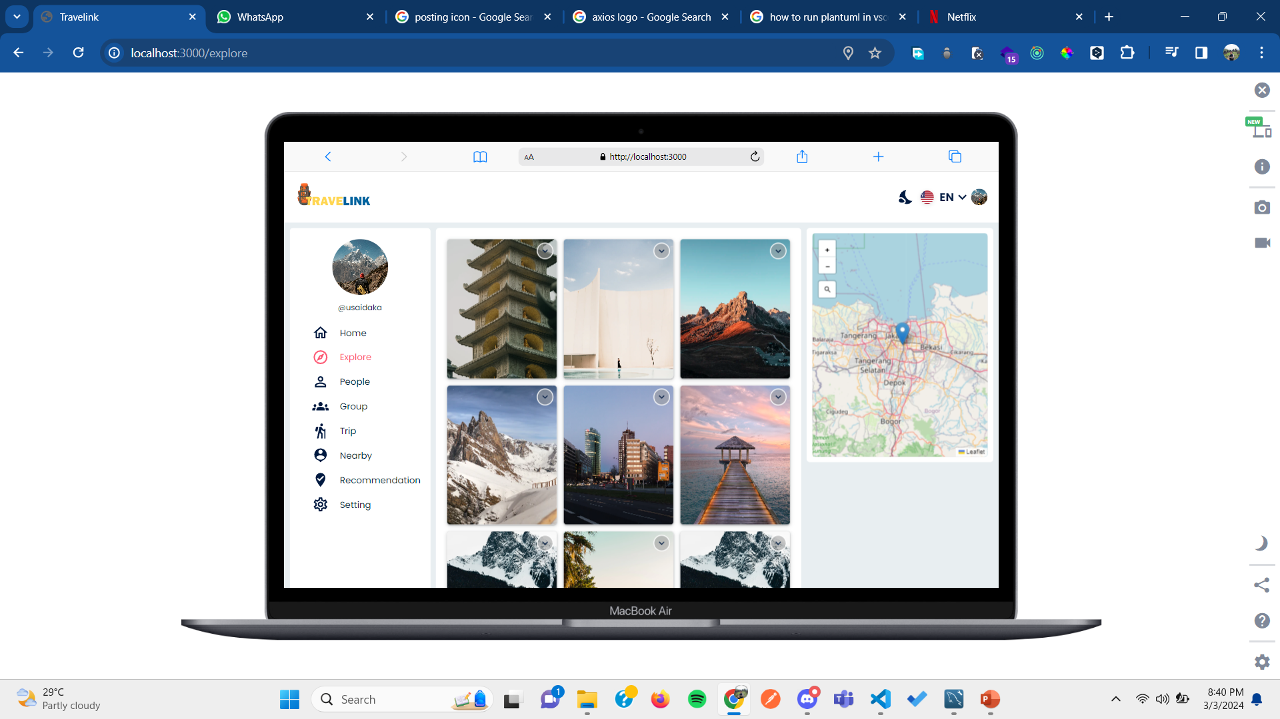
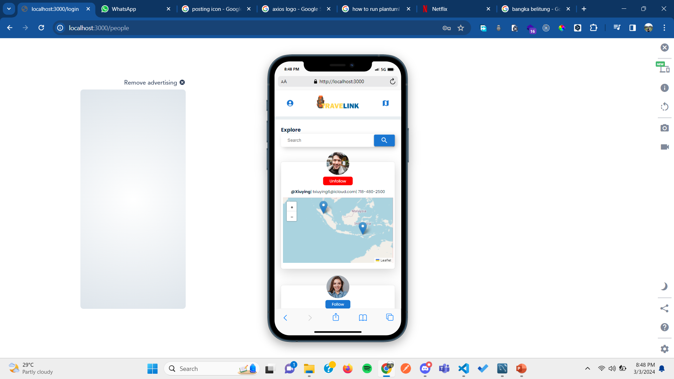
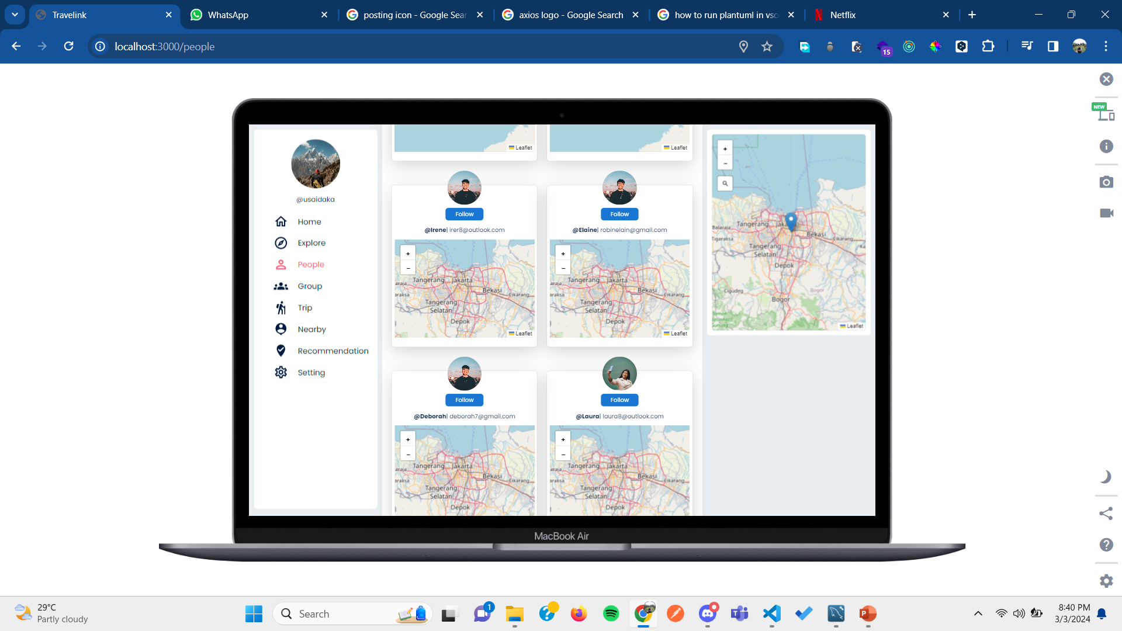
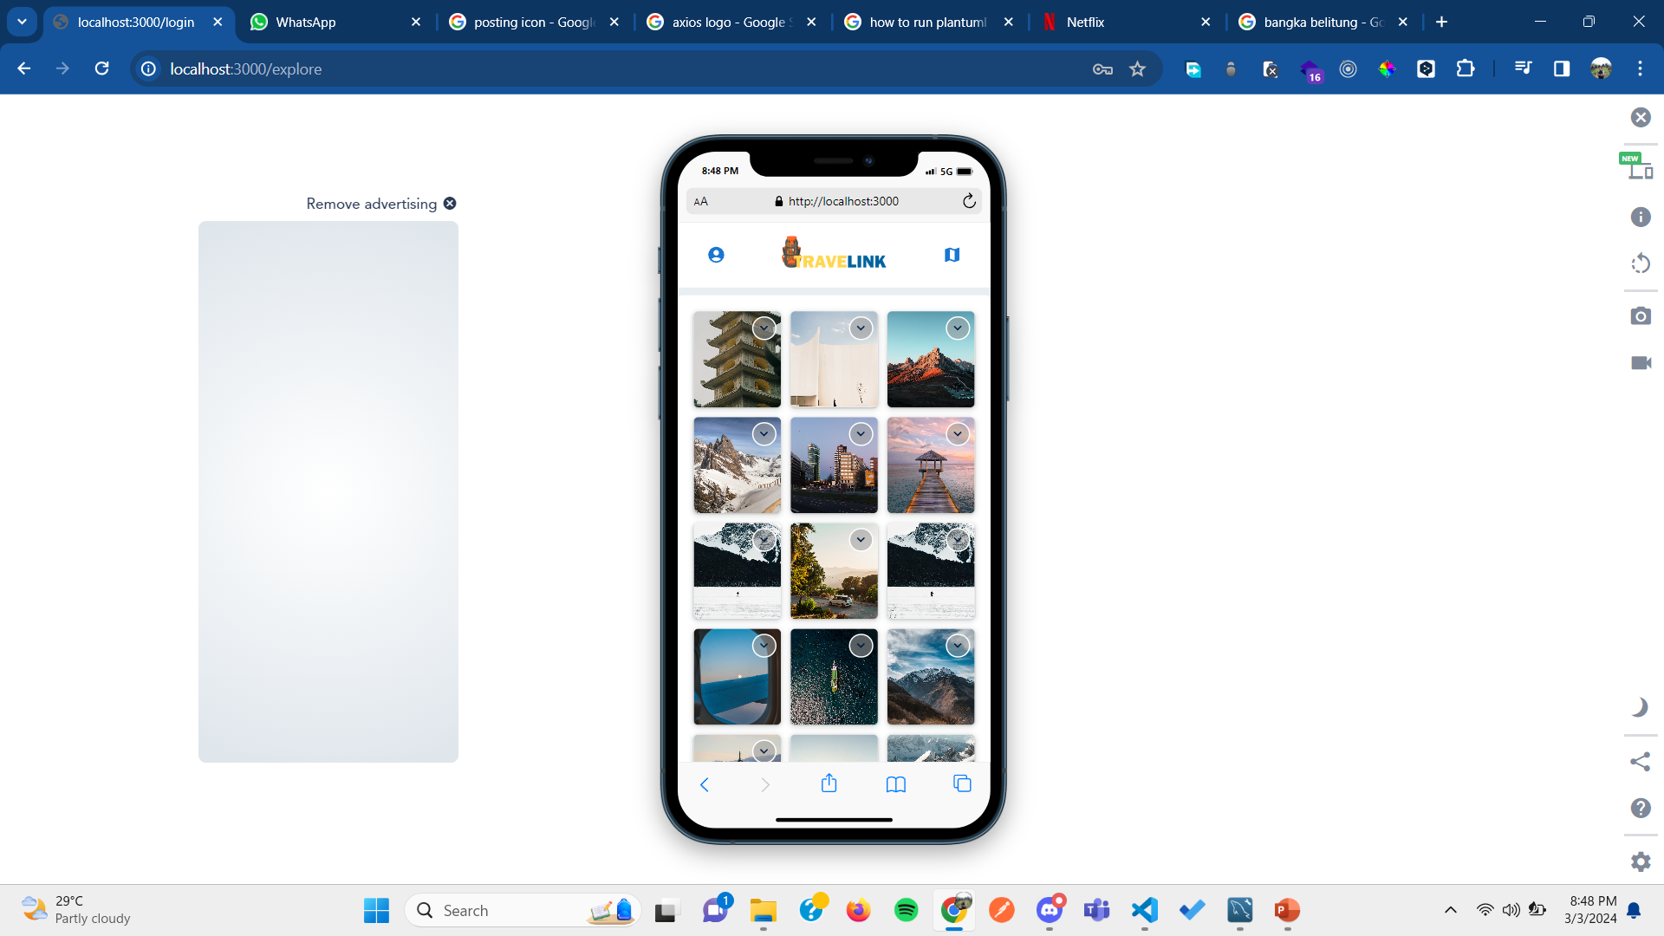
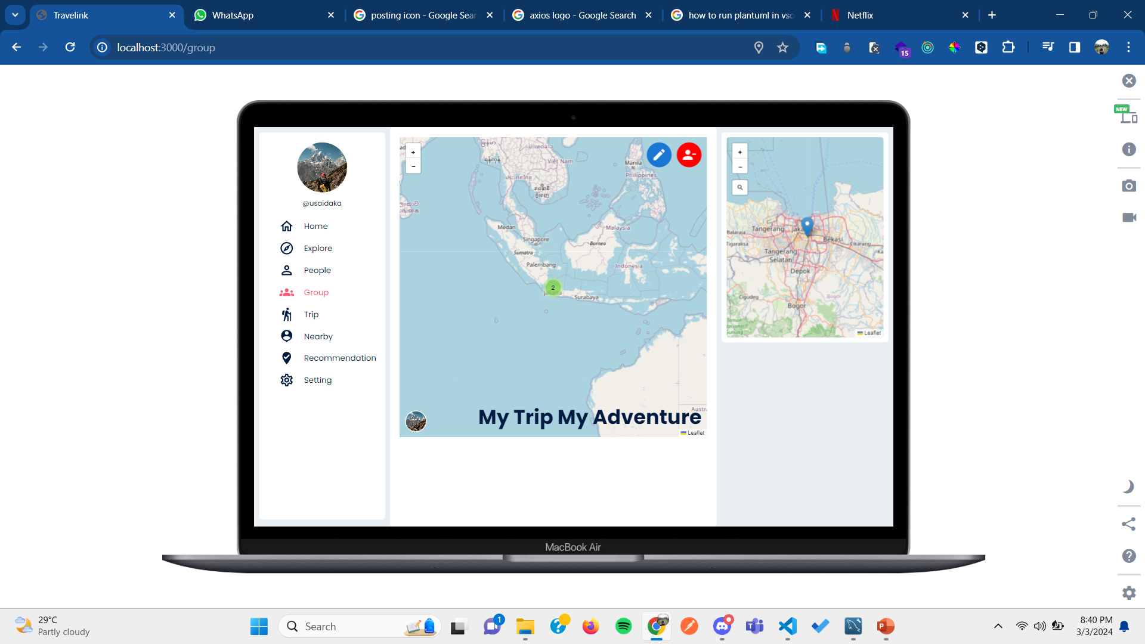
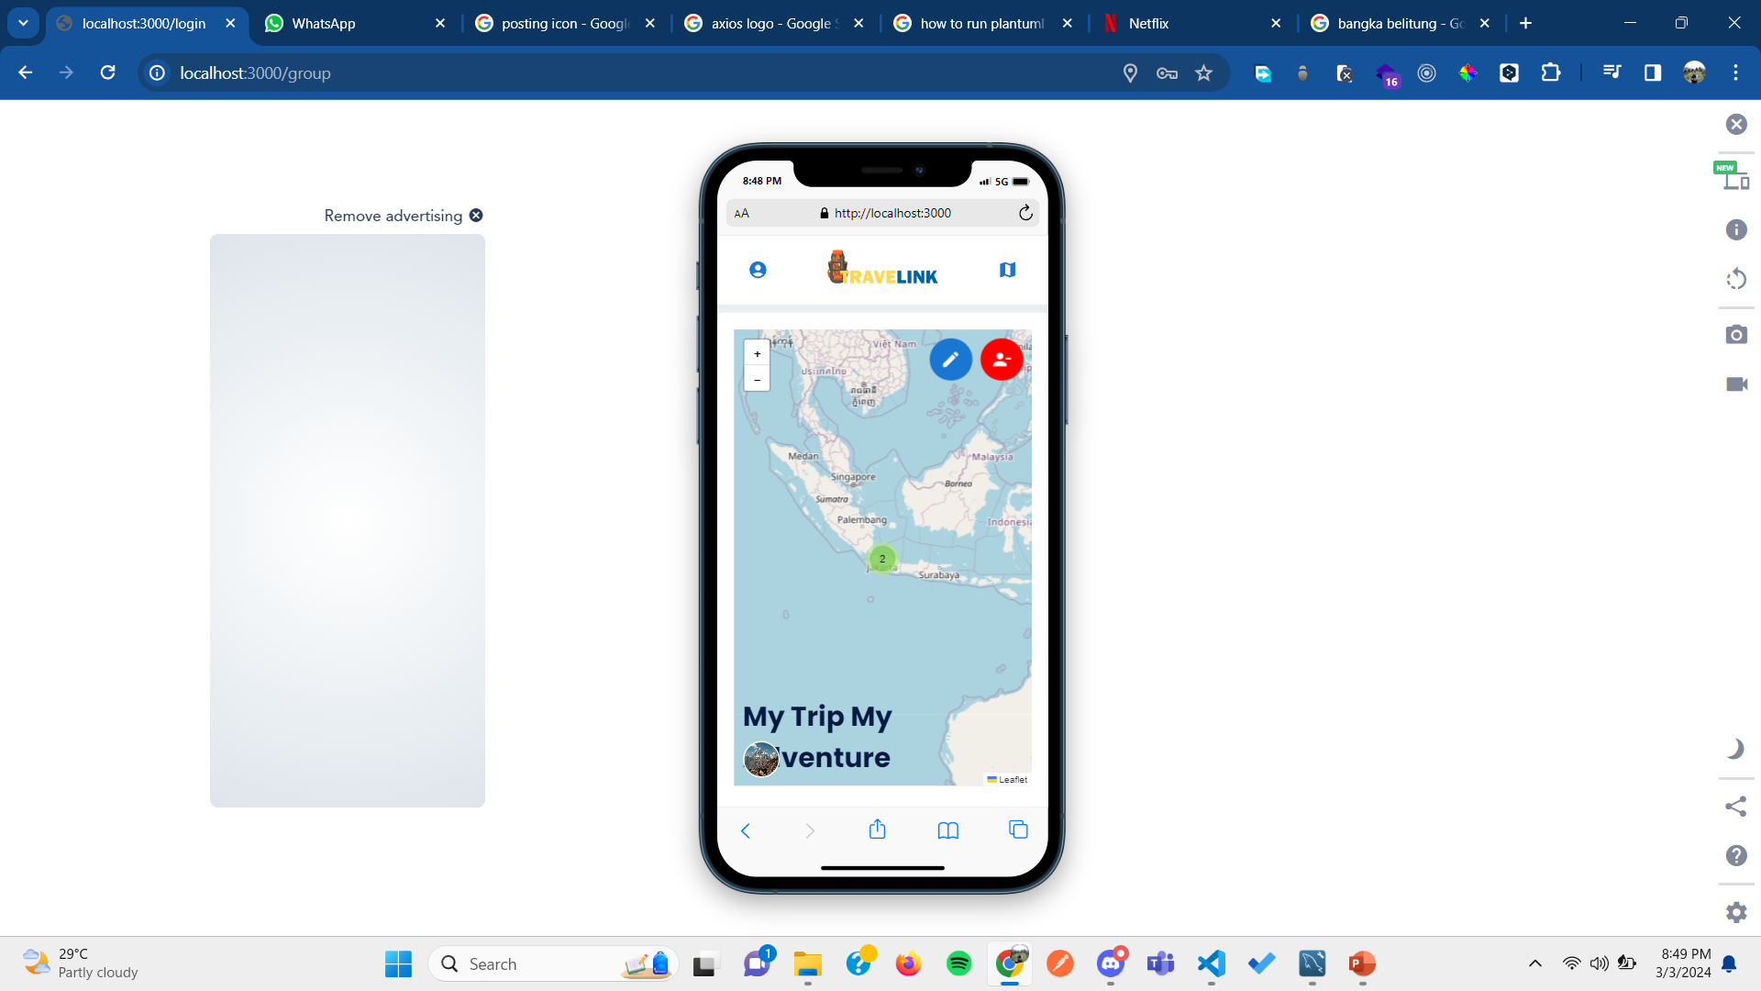
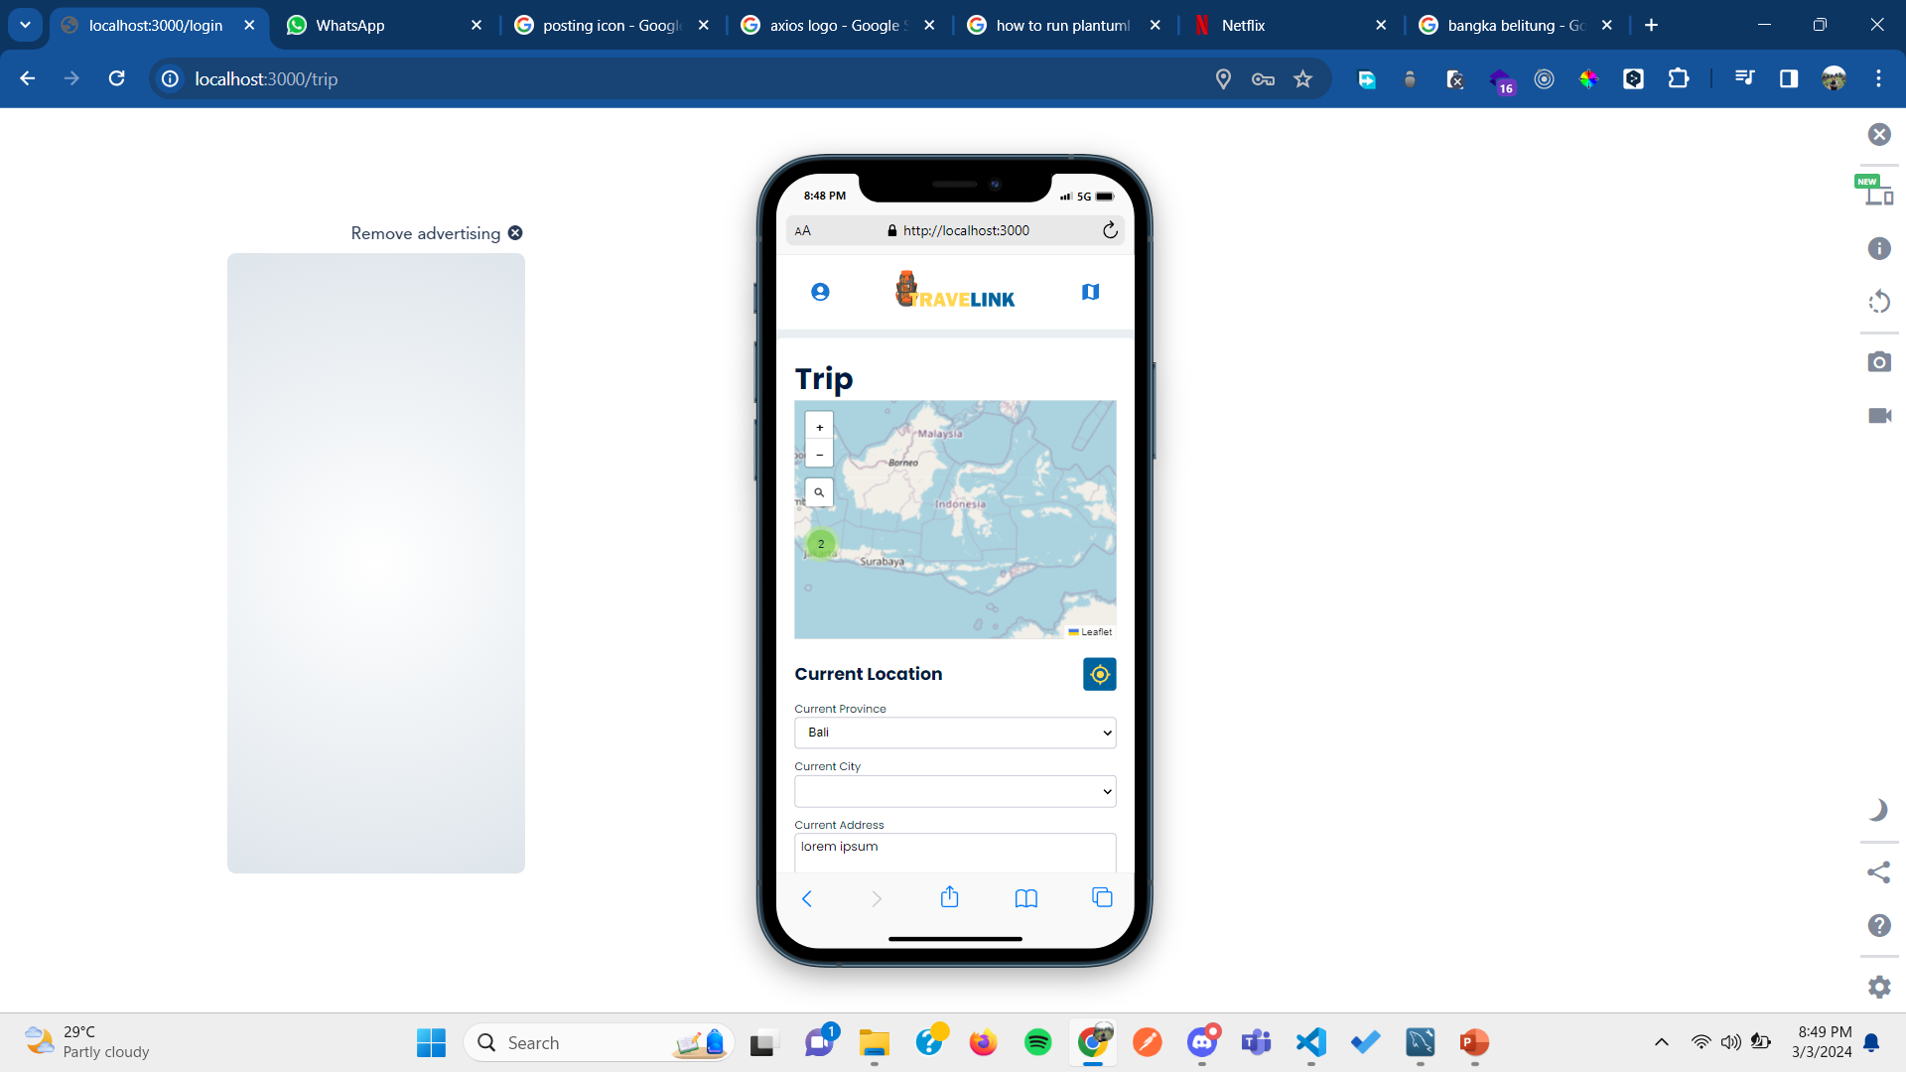
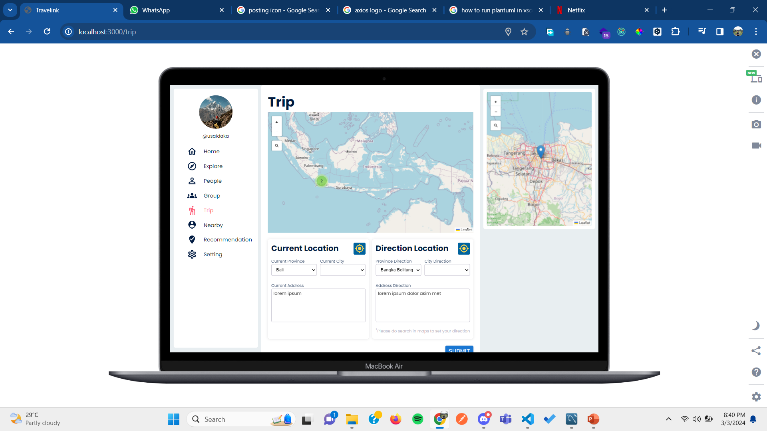
Entity
Relational
Diagram
PAGES
register
login
home
reset password
Explore
People
Group
Trip

Slide 11
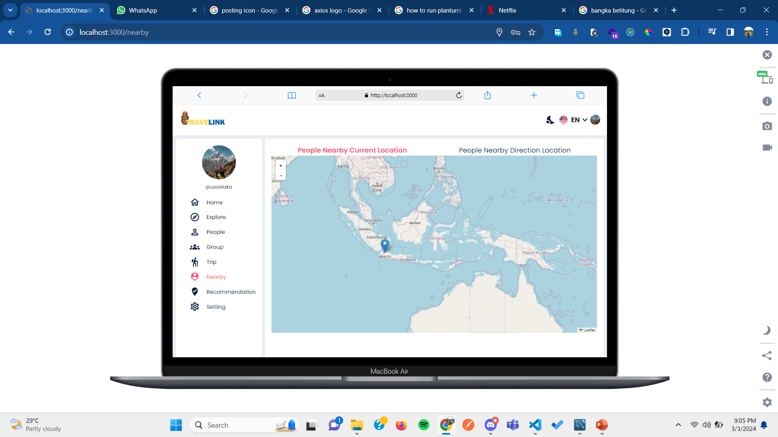
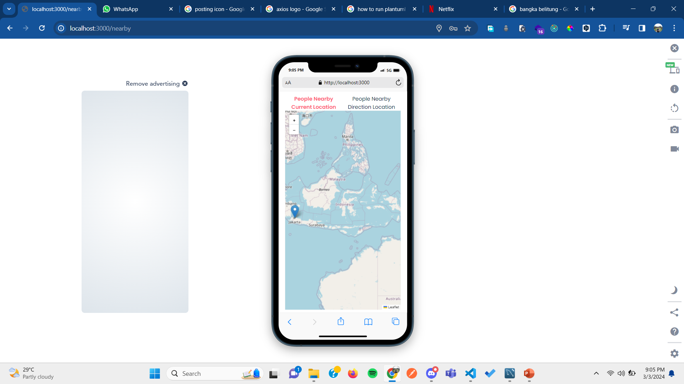
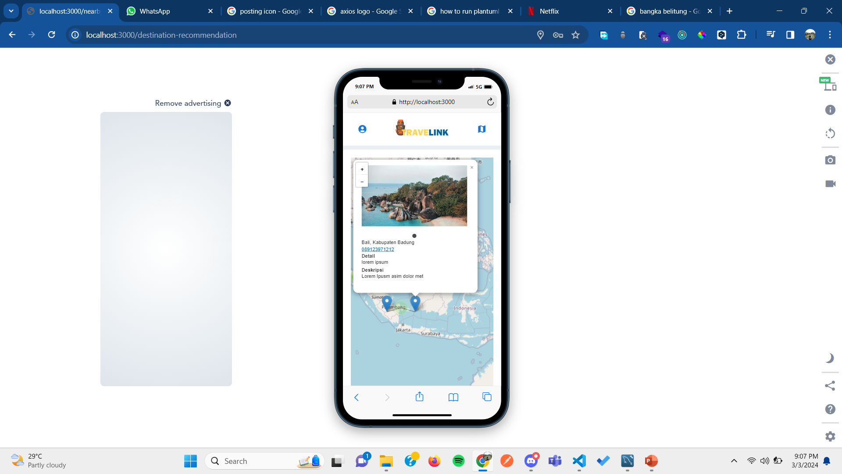
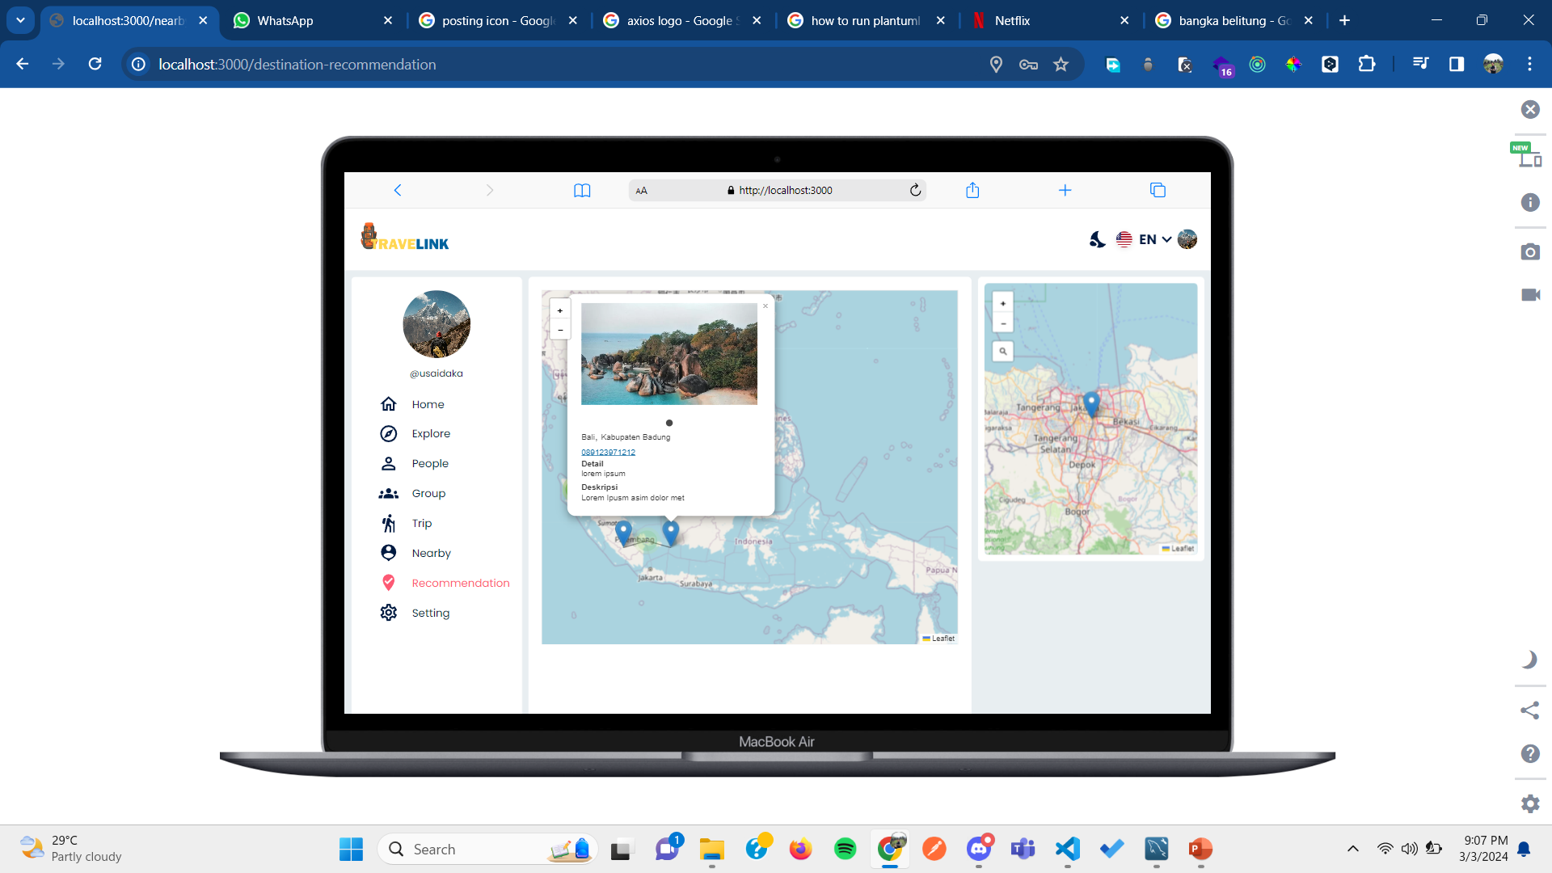
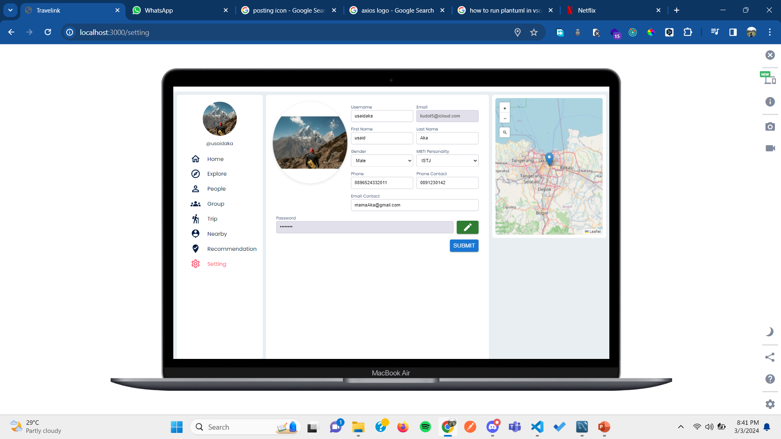
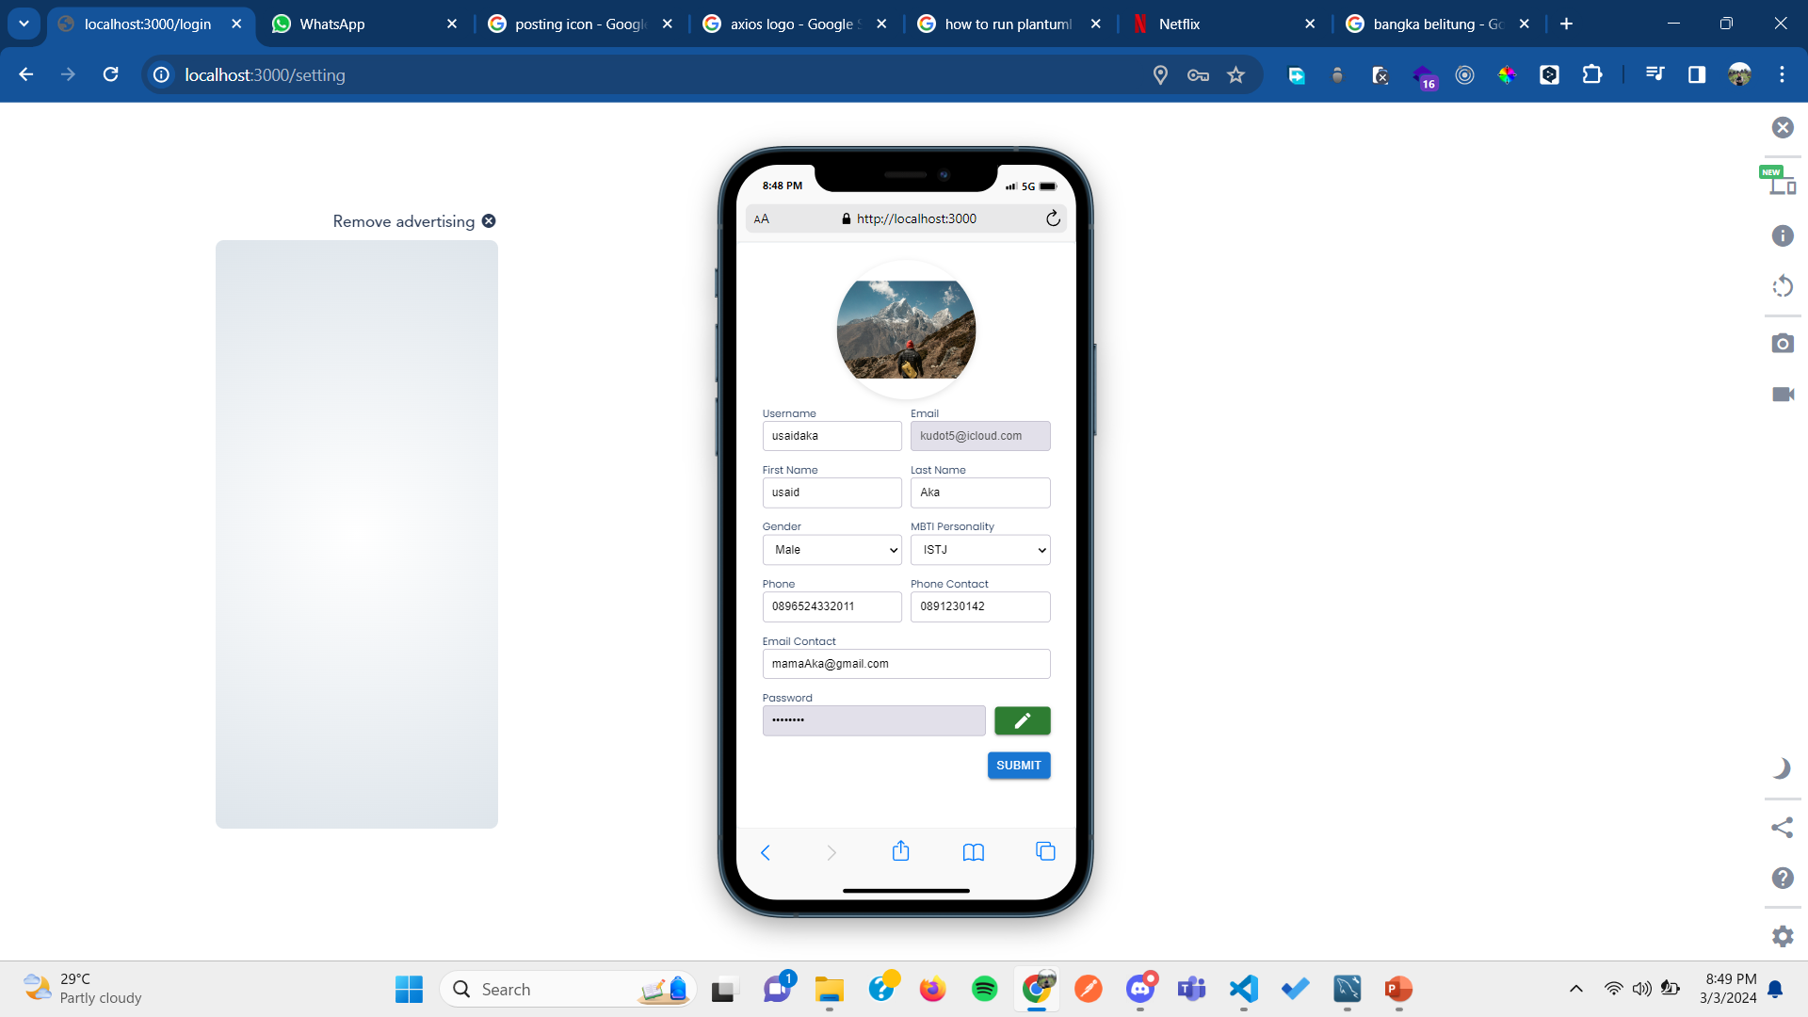
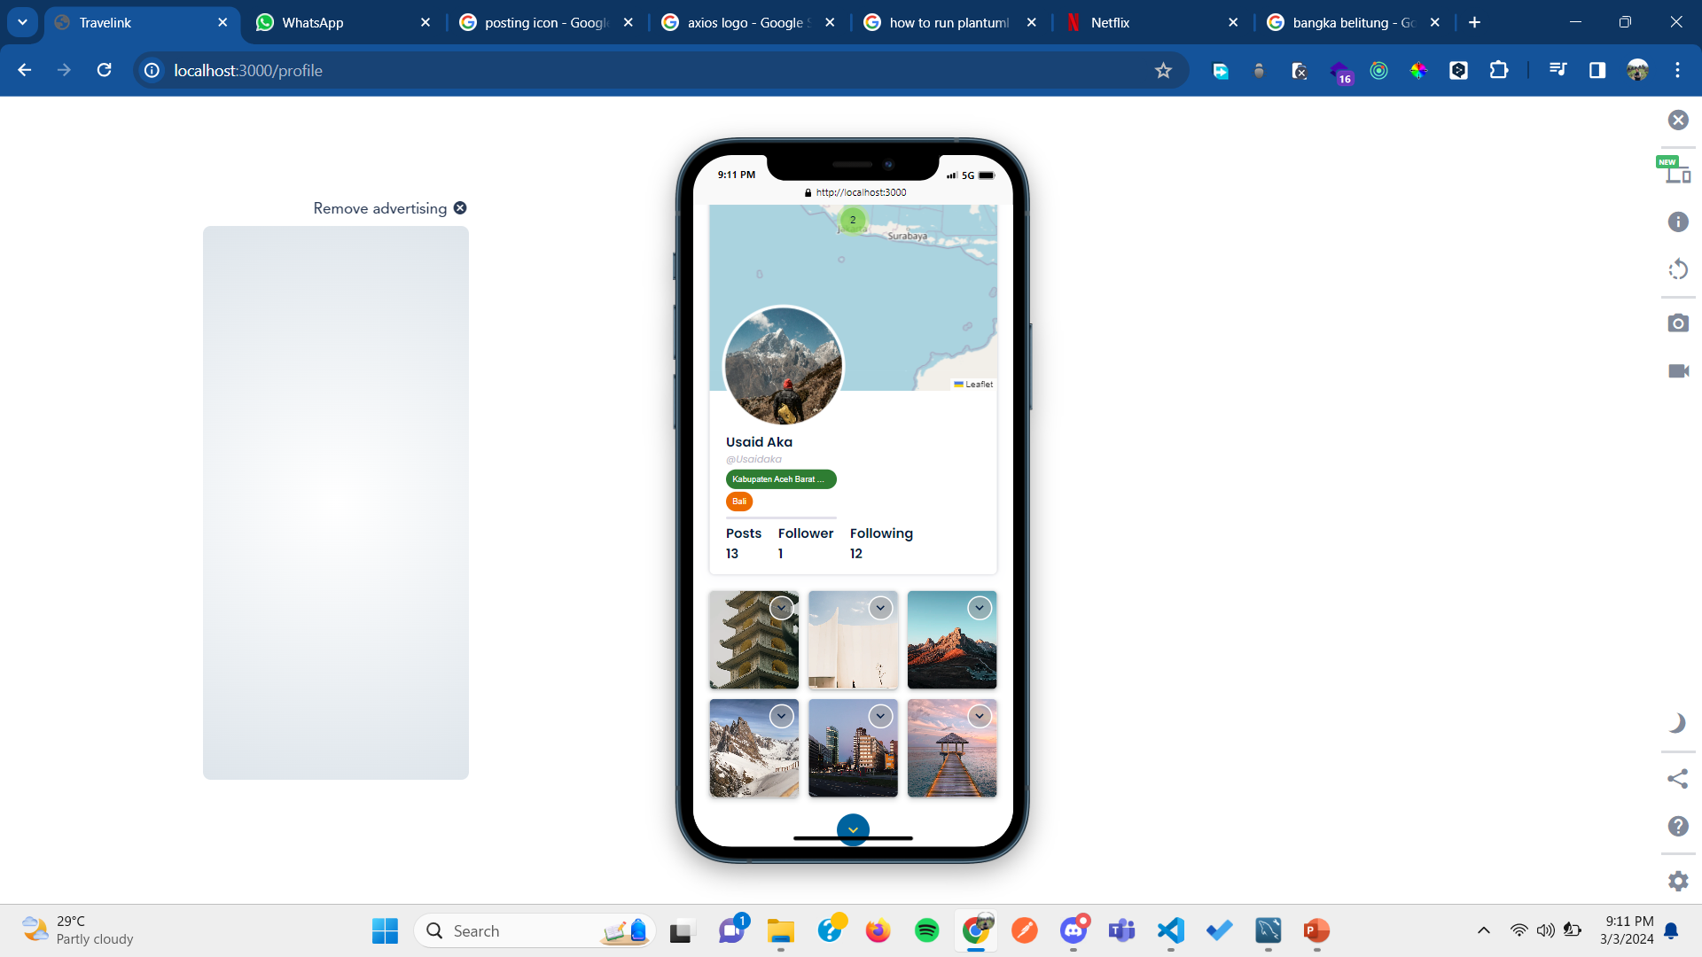
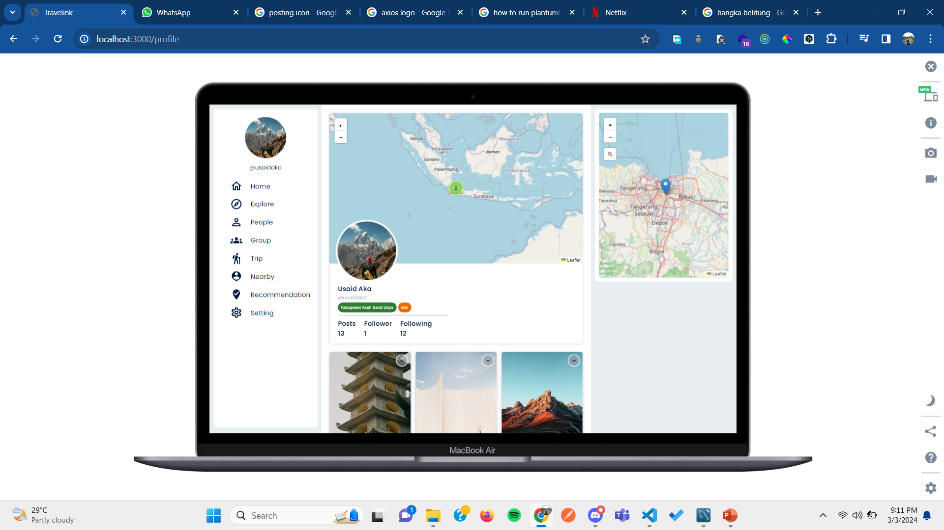
register
login
home
reset password
PAGES
Explore
People
Group
Trip
Nearby
Destination Recommendation
Setting
Profile

Slide 12
Explore
People
Group
Trip
PAGES
Nearby
Destination Recommendation
Setting
Profile

Slide 13
Explore
People
Group
Trip
PAGES
Nearby
Destination Recommendation
Setting
Profile

Slide 14
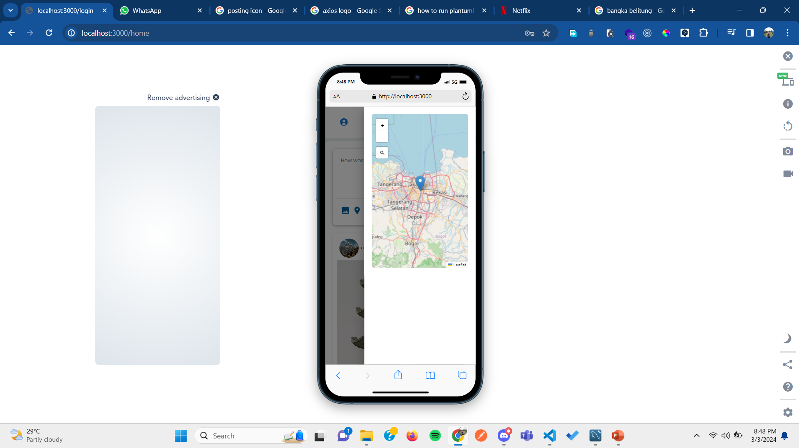
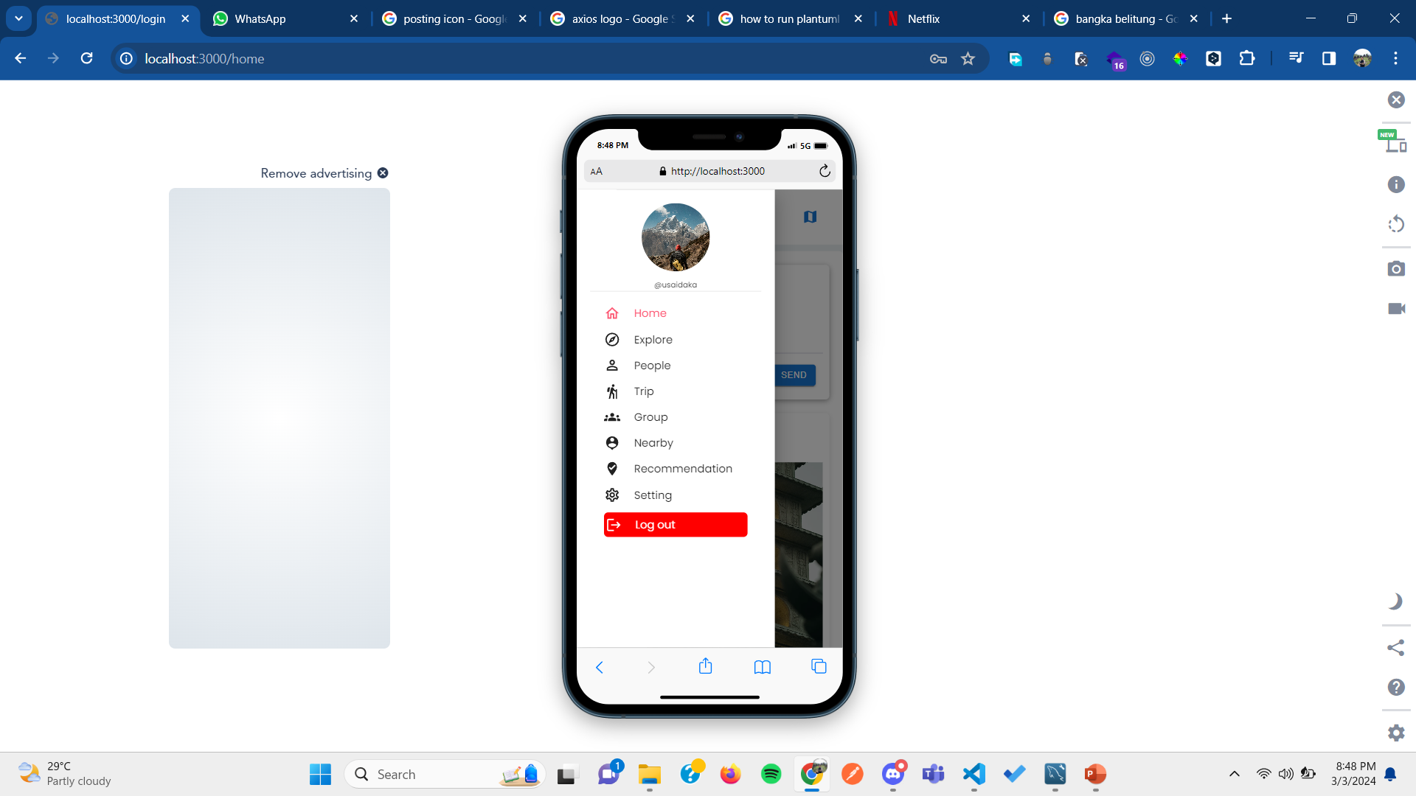
PAGES
Sidebar

Slide 15
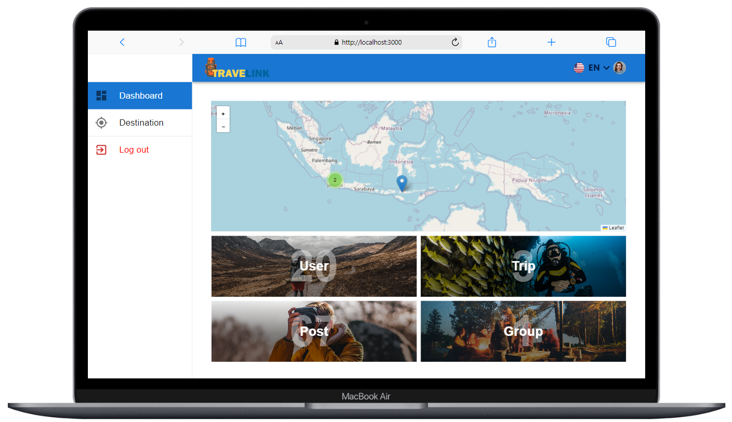
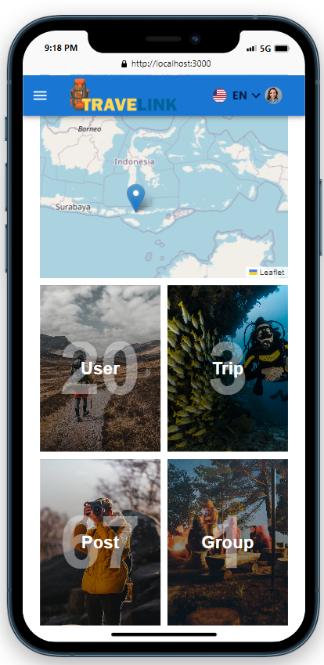
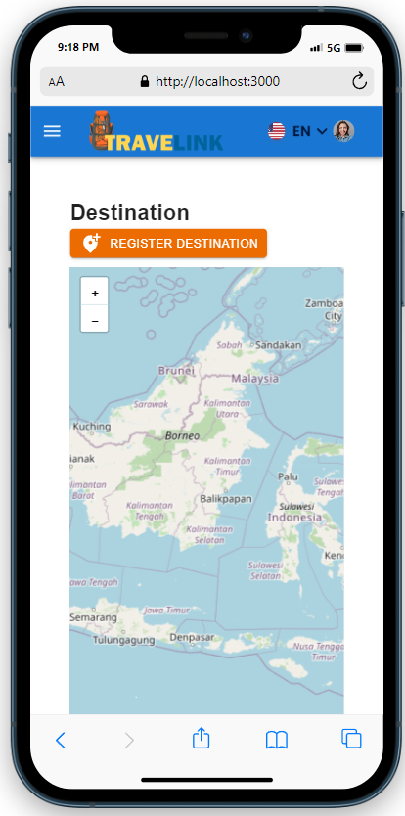
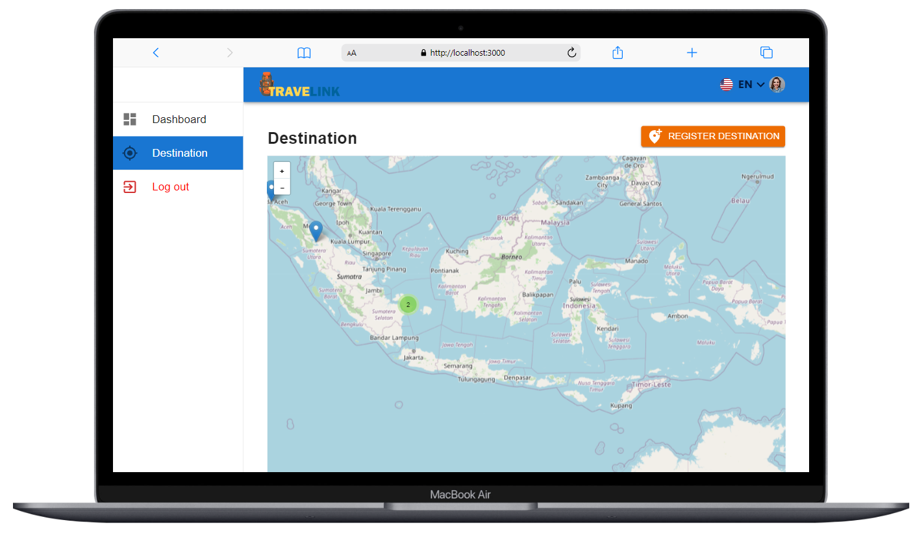
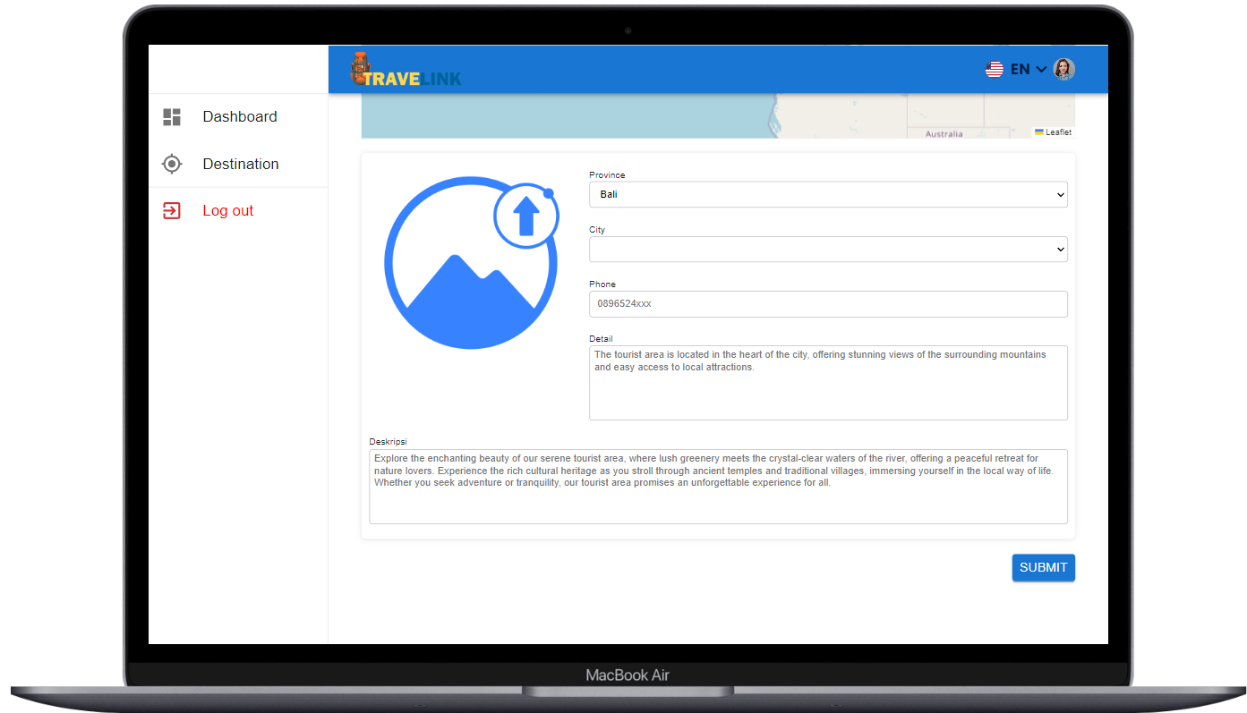
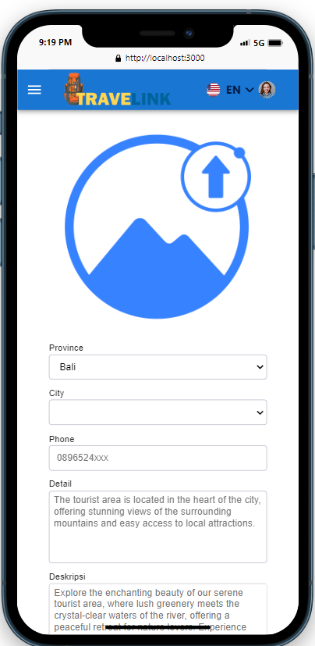
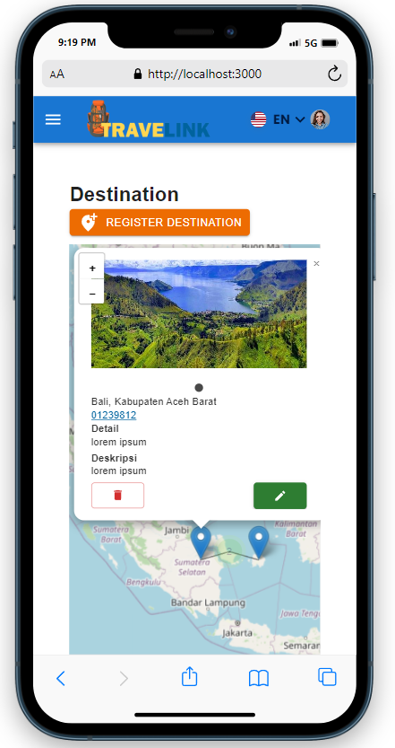
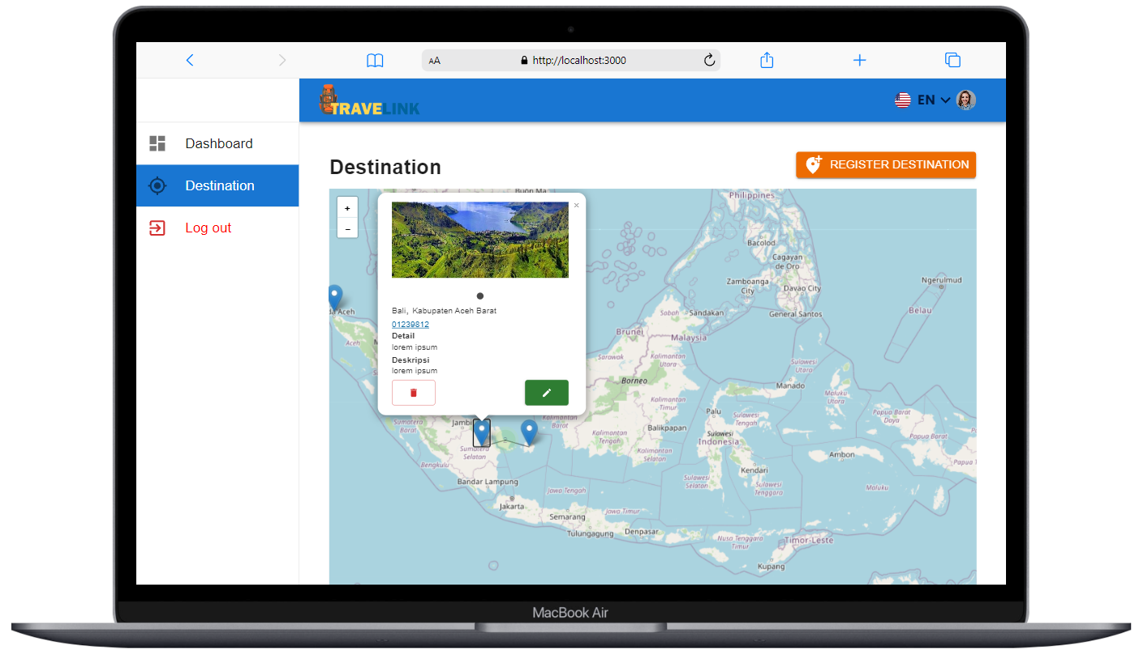

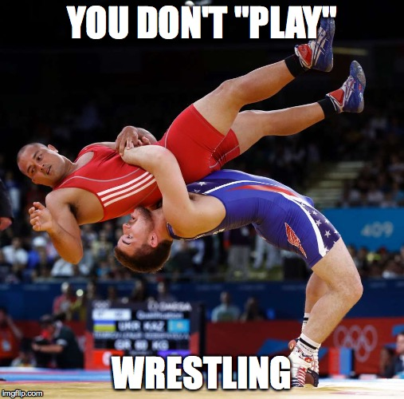
PAGES
Dashboard
Destination
Create Destination
Option Destination
Obstacle
Working with a full Work From Office (WFO) system within a short deadline has been quite challenging. This is because there is time and energy wasted on the journey due to traffic jams. With WFO and short deadline, pushing work until late at night needs to be controlled to avoid working too late into the morning, as there is a need to commute to the office in the morning.
There is a shortened deadline, leading to some features being taken down and also requiring a slight change in the initial concept that had been determined.

Slide 16
PAGES
Dashboard
Destination
Create Destination
Option Destination
Obstacle
Working with a full Work From Office (WFO) system within a short deadline has been quite challenging. This is because there is time and energy wasted on the journey due to traffic jams. With WFO and short deadline, pushing work until late at night needs to be controlled to avoid working too late into the morning, as there is a need to commute to the office in the morning.
There is a shortened deadline, leading to some features being taken down and also requiring a slight change in the initial concept that had been determined.

Slide 17
Obstacle
Working with a full Work From Office (WFO) system within a short deadline has been quite challenging. This is because there is time and energy wasted on the journey due to traffic jams. With WFO and short deadline, pushing work until late at night needs to be controlled to avoid working too late into the morning, as there is a need to commute to the office in the morning.
There is a shortened deadline, leading to some features being taken down and also requiring a slight change in the initial concept that had been determined.
Weakness and how I handle it
Front End
Personal
Back End
Leak of reference to create a good
design without any clue from UI/UX
person who is in a hurry
Handling race conditions.
I need some time to fully
understand how to make it secure.
I always instill the mindset that
it's better to complete tasks on
time and with clear attention to
all the necessary details.
I observe, imitate, modify, and add
design references by frequently
exploring.
Learning deeply about the business processes that occur so that I can implement real-world algorithms into code.
Unit testing, especially in mocking
any module From third party
easy person
I am always open about taking responsibility for my tasks, and I will manage additional tasks given to me according to their priority and urgency.
I actively study how to solve it by
continuously exploring the use
of third-party tools and testing
the modules used.

Slide 18
Obstacle
Working with a full Work From Office (WFO) system within a short deadline has been quite challenging. This is because there is time and energy wasted on the journey due to traffic jams. With WFO and short deadline, pushing work until late at night needs to be controlled to avoid working too late into the morning, as there is a need to commute to the office in the morning.
There is a shortened deadline, leading to some features being taken down and also requiring a slight change in the initial concept that had been determined.
Plan
COMPANY
Mastering the tech stack used deeply and
comprehensively.
learn more in the stack used
Having a good relationship with managerial
Having a good relationship with c level
Become a senior programmer and being able to mentor junior developers to help them grow into great programmers.
Having a good relationship with cross division.
Having a good relationship with seniors and being reliable in the team.
Become a tech lead and build a good team.
Become a architect software
become a mid-level programmer.
year
0
2
4
6
8
10
PERSONAL
Completing reading
Clean Code by Robert Cecil M,
The Pracmatic Programming by andy hunt and Dave Thomas
Refactoring by Kent Beck and Martin Fowler
Taking the initiative to get involved in broader projects as part of self-exploration.
Learning deeply about new technologies so I can be versatile in any situation if the company needs me to use another technology.
Exploring about Internet of things
Fully become a professional programmer and create a product to solve problem in socity
Exploring with new web technology or mobile technology
Learn public speaking so I can deliver a complex concept in programming to easily understand
Completing reading Modern Systems analysis and design by joseph S and Joey F
Exploring about Artificial intelegent

Slide 19



Suggestion
Provide more specific code implementation explanations for certain cases to facilitate a better understanding of the overall concept.
A comprehensive example code or boilerplate that can serve as a foundation for self-learning and further exploration.
Make it more interactive by including impromptu questions or light quizzes to ask the participants, so they are more disciplined in preparing themselves for the class.

Slide 20
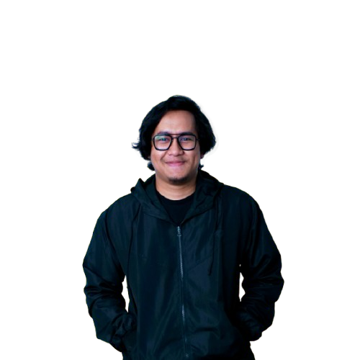
THANK YOU

